Slide 1
Thoracic Trauma
Dr. Vaibhav Kapare
Dept. Of Cardiovascular & Respiratory Physiotherapy MGM Institute Of Physiotherapy Chh. Sambhajinagar

Slide 2
Content;
Thoracic Trauma Facts
Anatomy
Specific Injuries
Physiology
Signs & Symptoms
Treatment

Slide 3
Thoracic Trauma Facts
Second leading cause of trauma deaths
Accounts for 25% of all trauma deaths
85% can be managed outside of the operating room
Major causes of Blunt Thoracic Trauma
Steering wheels. Bicycle handlebars, baseballs
Major cause of Penetrating Trauma
Gun shot wound and stabbing

Slide 4
Anatomy
Ribs
Spinal cord
Pleura space
Lungs
Heart
Great Vessels
Trachea
Mainstem Bronchi
Liver
Stomach
Spleen
Esophagus

Slide 5
Types of Injuries
Simple rib fractures
Flailed Chest
Pulmonary Contusion
Simple Pneumothorax
Open Pneumothorax
Tension Pneumothorax
Hemothorax
Impaled Objects
Myocardial Contusion
Pericardial Tamponade
Aortic Rupture
Traumatic Asphyxia
Tracheal Rupture
Diaphragmatic Rupture
Esophageal Rupture

Slide 6
Overview of Chest Injuries
Can be life-threatening
May result in damage to either the heart or the lung and cause severe internal bleeding
Rib cage fractures may result in serious injury to vital organs
Deep, open wounds allow air to enter the chest cavity
Closed wounds usually involve injury to the ribs and possibly underlying structures

Slide 7
Signs of Chest Injuries
An obvious chest wound
Impaired breathing
Irregular – or lack of – chest expansion
Coughing-up of blood
Shock
Subcutaneous emphysema: crackling sensation
Notes:
Of all signs, a change in the normal breathing pattern is the most indicative of chest injury.
A patient who has breathing difficulty will usually move in to a position where breathing is easiest. Typically this will be either sitting or reclining.

Slide 8
Rib Fractures
Rib Fracture Facts
Rib fractures are almost always the result of trauma (a blow) to the rib cage
Most commonly fx are 3-8
8-12 assoc. with spleen, kidney or liver injures
1 & 2 have high mortality because of the forces necessary to fx
Physiology
Very painful and cause patient to limit chest excursion
Limits tidal volume
Dramatically reduces air exchange

Slide 9
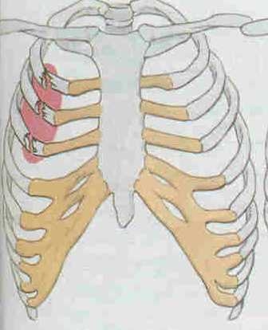
Rib Fracture

Slide 10
Rib Fractures Cont.
Signs & Symptoms;
Pain upon movement
leaning toward the injured side
If the rib has punctured a lung, air can escape into the tissues of the chest wall creating a crackling sensation (Subcutaneous Emphysema)
Unwillingness to take a deep breath/ Shallow breathing
Complaining of local pain and tenderness
Pain when moving the rib cage when breathing or coughing
Crepitus
Deformity
Hypoventilations
Potential for Pneumo/hemothorax

Slide 11
Treatment
C-Spine precautions
High flow O2
Reassess for BLS (3-5 mins)
Transport patient
Pain medication
Transport in seated position when possible.
Bed Rest & Support (Chest Brace) for 6 to 8 weeks.
Unstable Rib may require Surgery

Slide 12
Flail Chest
Several adjacent ribs fractured in more than one place can produce a loose section of the chest wall
The flail section moves inward when the patient breathes in, and outward when the patient breathes out
This phenomenon is known as paradoxical movement

Slide 13
Flailed Chest
Pathophysiology
When 2 or more adjacent ribs fractures in 2 or more places
Paradoxical movement when the flailed segment moves in opposite direct of the chest wall
also can occur when the sternum is fractured loose form its attachments with the ribs
Sign & Symptoms
Pain with movement
Decreased ventilatory volume
Lung contusion
Potential
Pneumo/hemothorax
Potential (flailed sternum)
Cardiac Tamponade
Traumatic Asphyxia

Slide 14
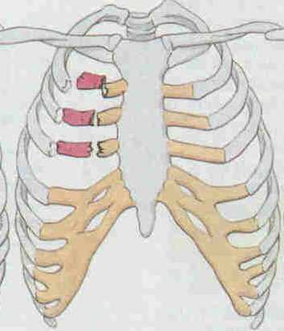
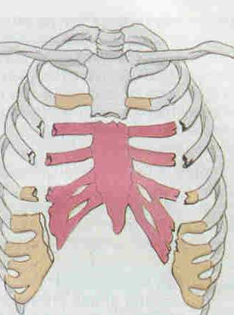
Flailed Chest

Slide 15
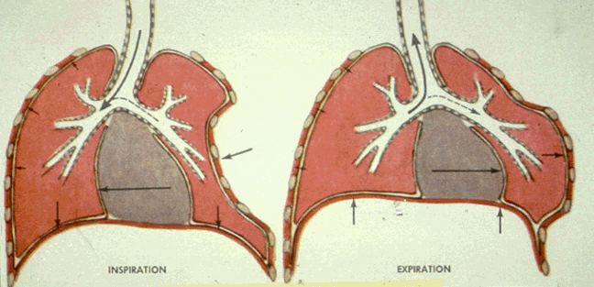
PARADOXICAL RESPIRATIONS

Slide 17
Flail Chest
Treatment
C-spine precautions
Stabilize flailed segment
Help the patient get in a comfortable position and transport to medical aid.
Implement I.V.s
Assist ventilation's if necessary
Intubate if require
Continue to monitor vital signs
Unless there is substantial bleeding, do not apply bulky padding or dressings
Bed Rest & Support (Chest Brace) for 6 to 8 weeks.

Slide 18
Use of Dressings on a Flail Chest
Only consider taped-on pad as a treatment in the following cases:
if there is likely to be a prolonged time before evacuation and access to medical care
if the patient has fatigued their chest muscles
To apply dressings
Press the segment inward with your gloved hand to stabilize it
Splint in the inward position with a pillow, large bulky dressing, or folded blanket.
Secure this thoroughly in place with tape
Be prepared to help breathing with AR
Do not hold in place with bandages encircling the chest. This would further impair the patient’s breathing effort
Notes:
The tape reduces the mobility of the chest wall and thus limits the already compromised expansion of the lung.

Slide 19
PRECAUTIONS AND CONTRAINDICATIONS FOR THE MANAGEMENT OF PATIENTS WITH THORACIC INJURY
Support/ Splint any thoracic surgical site manually during coughing to reduce the amount of pain induced.
Avoid chest shaking and vibrations over rib fracture sites, as chest compression during the performance of these techniques can cause inwards movement of the fracture segment s and result ant damage to the underlying lung tissue and other pulmonary structures.

Slide 20
In the presence of acute pulmonary oedema, the use of manual chest clearance techniques and airway suctioning is contraindicated, as it contributes to lung volume loss due to the removal of surfactant from the airways.
No chest therapy techniques should be used around the insertion site of the intercostal drainage (ICD) tubing into the chest wall, as it causes discomfort for the patient.
Underwater sealed drainage precautions should be taken.
NIV can be Consider to reduce WOB
Inspiratory Breathing Exercise can be started as patient stabilized.

Slide 21
Questions??

Slide 23
Pulmonary Contusion
Physiology
Interstitial and alveoli bleeding within the lung
Usually associated with flail segment
Can lead to respiratory failure.
Interstitial fluid collects between capillaries and alveoli and decreases oxygenation.
Signs & Symptoms
Mechanism of injury present
Painful
Treatment
C-Spine precautions
High flow 02
Assist ventilations when necessary
IV (avoid excessive fluids)

Slide 24
Simple Pneumothorax
Physiology
Air in the pleural space
Affected lung begins to collapse as pleural space expands
Cause by rib fx or lung defect
Signs & Symptoms
Dyspnea
Pleuritic chest pain
Tachypnea
Decreased lung sounds

Slide 25
Simple Pneumothorax
Treatment
C-Spine precaution (when indicated)
Anticipate development of tension
Semi-sitting position (unless contraindicated)
High flow 02
Assist ventilations (as necessary)
Large bore IV
Monitor
Treat other injuries

Slide 26
Open Pneumothorax Sucking Chest Wound
Physiology
Open chest wall injury
Stab wounds usually self-sealing
GSW more extensive damage
Air passes through opening into the pleural space and remains outside of lung
Notes:
Need to finish Physiology for this. Add picture of stabbing in back.

Slide 27
Open Pneumothorax Cont..
Signs & Symptoms
Gurgling sound during air movement
Bubbling wound
Dyspnea
Tachypnea
Diminished breath sound

Slide 28
Open Pneumothorax Cont.
Treatment
Anticipate tension pneumothorax
Cover wound with three sided dressing or with a flutter valve.
High Flow 02
Assist ventilations if needed
Two Large Bore IV
Monitor
Transport to Level 1 Trauma Center

Slide 29
Tension Pneumothorax
Physiology
Air enters pleural space and becomes trapped leads to pressure increase
Increased pressure further collapses lung and shifts mediastinum to unaffected side
Increased dyspnea and compressed heart and great vessels leads to decreased cardiac output.
Leads to Cardiogenic Shock

Slide 30
Tension Pneumothorax Cont..
Signs & Symptoms
Dyspnea
Tachypnea
Anxiety
Diminished lung sounds
Hypotension
Tachycardia
JVD
Narrowing pulse pressure
Tracheal Deviation
Late Sign
Shock

Slide 31
Tension Pneumothorax
Treatment
High flow 02
Maintain Pt’s airway
Assist ventilations
Needle decompression
2 Large bore IV
Treat shock

Slide 32
Hemothorax
Physiology
Blood in the pleural space
Each side of the chest can hold 2500-3000ml of blood
Possible Sources
Intercostal vessels
Pulmonary vessels
Lung
Can lead to tension pneumothorax

Slide 33
Hemothorax Cont.
Signs & Symptoms
Related more to blood loss than lung collapse
Tachypnea
Anxiety
diminished lung sounds
S&S of Shock
Treatment
Rapid Transport
High Flow 02
Assist ventilations
2 large bore I.V.s
ECG
Treat other injuries

Slide 34
Myocardial Contusion
Physiology
Usually from impact with steering wheel
3 injury patterns
Myocardial contusion
Electrical conduction system
Myocardial rupture
Right ventricle usually injured due to its location behind the sternum

Slide 35
Myocardial Contusion Cont.
Signs & Symptoms
Chest Pain similar to MI
Palpitations
Dysrhythmias
Sinus Tach
PAC’s
PVC’s
Bundle Branch Block
EKG Changes
ST segment
T wave

Slide 36
Myocardial Contusion Cont.
Treatment
C-Spine
High flow 02
Monitor
2 large bore IV
Treat Dysrhythmias
Treat other injuries
Rapid transport

Slide 37
Pericardial Tamponade
Physiology
Collection of blood between heart and pericardium
Source of blood can be coronary arteries or myocardium.
Pericardium may hold up to 200-300ml of blood before S&S develop

Slide 38
Pericardial Tamponade Cont.
Signs & Symptoms
Tachycardia
Paradoxical pulse
JVD
Narrowing pulse pressures
Muffled heart sounds
S&S of shock
Beck’s Triad
MHS
JVD
Hypotension

Slide 39
Pericardial Tamponade
Treatment
C-Spine
High flow 02
EKG
2 Large bore IV
MAST?
Transport to closest facility

Slide 40
Aortic Rupture
Physiology
Usually in frontal crashes
80-90% fatality rate
Tears at ligamentum arteriosum near distal portion of aortic arch
2/3 of patients surviving will die within 24hours
Surgery can prevent most deaths for patients who survive initial injury

Slide 41
Aortic Rupture Cont.
Signs & Symptoms
1/3 of patients have no S&S
Difference in pulse strength in arms or between arms and legs
S&S Shock
Treatment
RAPID TRANSPORT TO LEVEL 1 TRAUMA CENTER
Airway
High flow 02
2 large bore IV (Do not overload on fluids)

Slide 42
Tracheal Bronchial Rupture
Physiology
Often associated with rupture of major vessels.
Ruptures usually located in upper trachea, larynx or bronchi just below the carina.
Is rare less then 3% of victims of blunt or penetrating chest trauma

Slide 43
Tracheal / Bronchial Rupture
Signs & Symptoms
Dyspnea
Cyanosis
Severe hypoxia
Spitting blood
Tachycardia
S&S of shock
SQ emphysema
Treatment
C-spine
Closely monitor Airway
Assist ventilations prn
large bore IV
EKG
Treat Shock
Transport to level 1 trauma center

Slide 44
Traumatic Asphyxiation
Physiology
Crushing chest injury which forces blood out of right side of heart into veins of upper chest and neck
Blood forced into head and neck producing micro-rupture, CVA, Seizures,JVD

Slide 45
Traumatic Asphyxiation
Signs & Symptoms
Cyanosis of head & neck
Profound JVD
Puffy eyes
Protruding eyes

Slide 46
Traumatic Asphyxiation
Treatment
C-Spine
Aggressive Airway management
Monitor
2 large bore IV
Consider Sodium Bicarb 1mEq/kg IV drip
Transport to Level 1 trauma center

Slide 47
Diaphragmatic Rupture
Physiology
results from compression of anterior abdomen
Abdomen contents herniated into thorax cavity
Left side herniation more common and more serious
Decreases lung expansion

Slide 48
Diaphragmatic Rupture Cont.
Signs & Symptoms
Abdominal pain
Dyspnea
Diminished breath sounds
Bowel sounds in chest
S&S of Shock
Treatment
C-spine
High flow 02
Airway Control
Assist ventilations prn
Treat shock
Transport to level 1 trauma center

Slide 49
Esophageal Rupture
Physiology
Nearly 100% fatal if untreated
Well protected, not usually injured
Creates mediastinitis

Slide 50
Esophageal Rupture Cont.
Signs & Symptoms
Pain
Coughing blood
Choking
Vomiting blood
SQ emphysema
Treatment
C-Spine
Protect Airway
High flow 02
Large bore IV
EKG
Treat shock
Associate with other chest injuries
Transport to level 1 trauma center

