Slide 1
ULTRAVIOLET RADIATION (UVR)
Dr. Santosh Dobhal
Dept. Of Cardiovascular & Respiratory Physiotherapy
MGM Institute Of Physiotherapy
Chh. Sambhajinagar
I

Slide 2
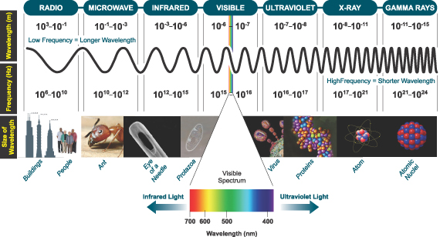
INTRODUCTION
Ultraviolet radiation (UVR) covers a small part of electromagnetic spectrum lying between the violet end of the VISIBLE LIGHT and X-RAY REGION.

Slide 3
Introduction
UVR are INVISIBLE to the human eyes.
Natural source of UVR is SUN.
UVR provoke CHEMICAL CHANGES & not simply heat at sites where they are absorbed.

Slide 4
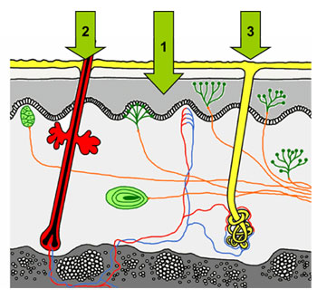
Introduction
The radiations introduced to the tissues through 1.subcutaneous tissue, 2.hair follicles, and 3.sebaceous glands.

Slide 5
Types of UVR
1. UVA (Long UV) – 400 – 315nm. {penetrates to dermis, Responsible for development of slow natural tan}
2. UVB (medium UV, erythemal UV) –
315 – 280nm. {Produces new pigment formation, sunburn, Vitamin D synthesis. Responsible for inducing skin cancer}
3. UVC (short UV, germicidal UV) –
280 – 100nm {Does not reach the surface of the earth}

Slide 6
Generalized response to UVR Exposure
Sunburn (UVB) / Erythema ( Reddening of the skin)
Tanning of the skin / Pigmentation
Decrease in sensitivity of the skin (Increased Epidermal thickness)
Premature aging of the skin (UVA)
Skin cancer (UVB)
Exposure to the eye causes photokeratitis (UVB)
Photosynthesis of vitamin D

Slide 7
The physical Behavior of UVR
1. Reflection
2. Refraction
3. Absorption
4. Penetration

Slide 9
UVR Generators
1. High pressure mercury vapor lamp – Air cooled.
2. High pressure mercury vapor lamp – Water cooled ( Kromayer lamp).
3. Fluorescent lamps

Slide 10
PENETRATION OF THE Uv rays
UVA – Dermis level.
UVB – Deep Epidermis

Slide 11
Physiological effects of UVR
The UVR physiological effects may be divided into 2 groups;
Local – Effects which produced locally in the area.
General – Results from a widespread Irradiation.

Slide 12
Local effects of uvr
1. ERYTHEMA – It is reddening of the skin.
First observable effect of UV Irradiation.
It cause chemical action which result in IRRITATION & DESTRUCTION of cells. This causes liberation of “H”-substance which produce the TRIPLE RESPONSE.
The erythema is regarded as an inflammatory reaction stimulated by the UVR.

Slide 13
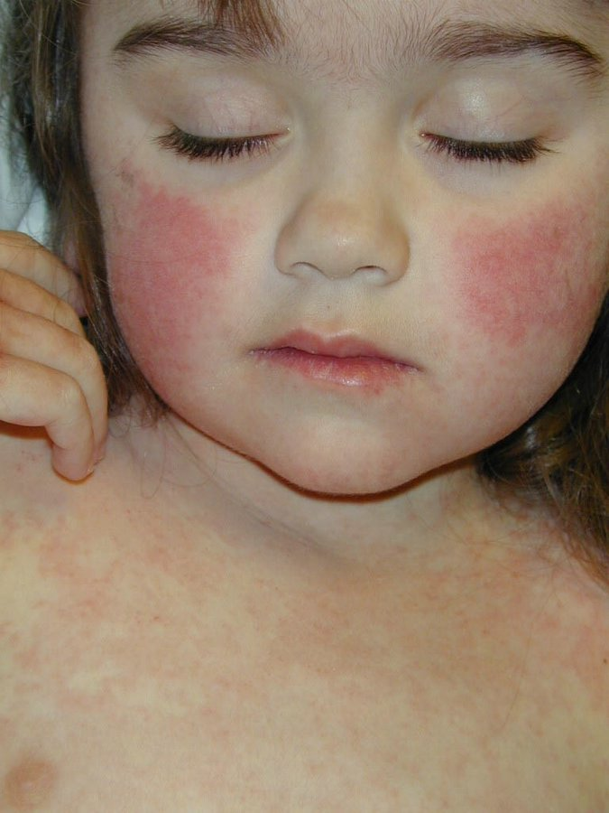
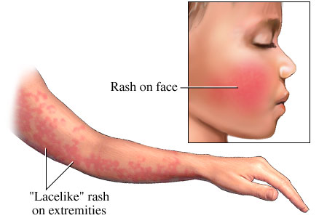
TRIPLE RESPONSE
1. Dilation of capillaries – H-substance
2. Dilation of arterioles – Axon reflex
3. Exudation of fluids into the tissues – Increased permeability of the capillary walls.

Slide 14
2. Pigmentation / tanning
It is thought that the UVR stimulates MELANOCYTE & ACCELERATES the production of MELANIN PIGMENT.
Pigmentation commonly follows an erythemal reaction.
It varies with the dosage of UVR & the different individuals.

Slide 15
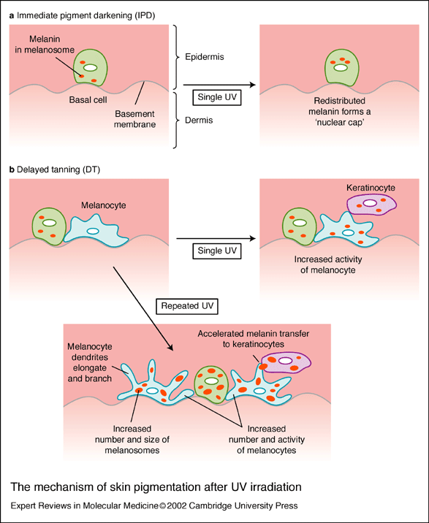

Slide 16
2. Pigmentation / tanning
Sometimes immediate tanning occurs as a result of effects of PRE-EXISTING melanin. This may occur within minutes of exposure.
Sun / Carbon arc Brown color
Mercury Vapor lamp Grayish
The pigmentation REDUCES the penetration of UVB.

Slide 17
3. Thickening of epidermis
UVR provokes an increased reproduction of KERATINOCYTES.
This leads to thickening of epidermis which acts does acts a PROTECTION AGAINST THE RAYS.
So longer doses are required to repeat an ERYTHEMAL reaction.

Slide 18
4. Desquamation / peeling
It is the CASTING OFF of dead cells from the surface of the skin.
The desquamation is proportional to the intensity of the erythema.
The peeling results in REDUCTION / LOSS OF THE INCREASED RESISTANCE TO THE RAYS.

Slide 19
5. Antibiotic effect
Destructive effects of ultraviolet radiation include the destruction of viruses, bacteria, and other small organisms on the skin surface such as FUNGI commonly found in wounds. (effect of UVB).

Slide 20
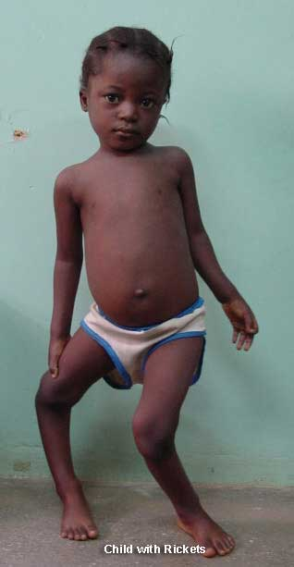
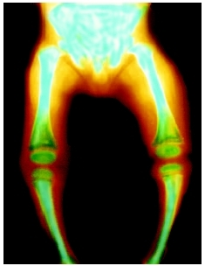
B. General effects of UVR
1. Vitamin D Production
In the presence of UVB, converts 7-Dehydrocholestrol into Vitamin – D through chemical reaction.
Vitamin D is required to assist in the absorption of calcium and phosphorous from the intestine to blood stream.

Slide 21
2- The Esophylactic effect
General UVA Irradiation
Stimulation of reticulo - endothelial system
Ingest bacteria & produce ANTIBODIES against
BACTERIA & TOXINS.
So the resistance of the body to infection is increased & this being known as ESOPHYLACTIC EFFECT.

Slide 22
3. GENERAL TONIC EFECT
Its being claimed that because of General UV Irradiation has a
GENERAL TONIC EFFECT,
APPETITIE & SLEEP BEING IMPROVED
NERVOUSNESS & IRRITABILITY DECREASED

Slide 23
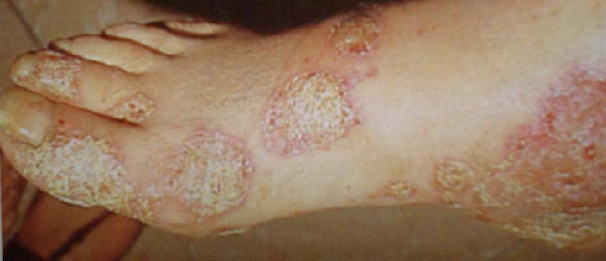
Therapeutic effects of uvr
The principle therapeutic uses of UVR are of SKIN DISEASES
1. PSORIASIS:-
It is a skin condition which presents localized THICK PINK / RED plaques, sharply demarcated & covered with SILVERY SCALES.
In this state the aim of UVR irradiation is to decrease the DNA synthesis in the cells of the skin & to improve the skin condition

Slide 24
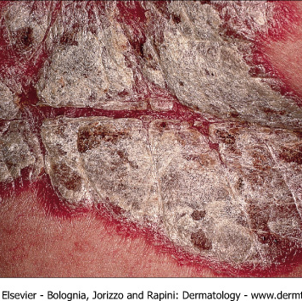
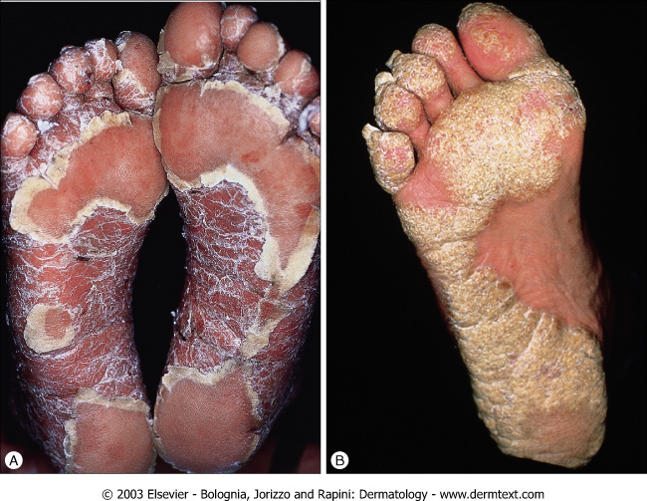
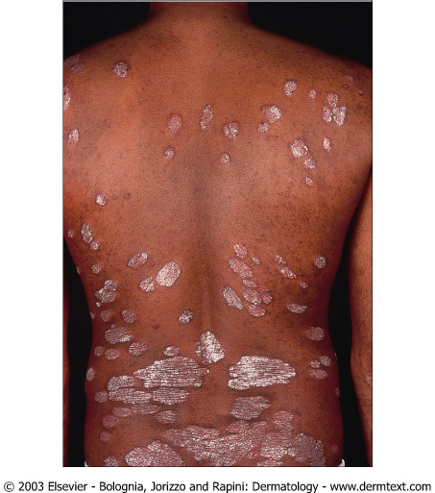
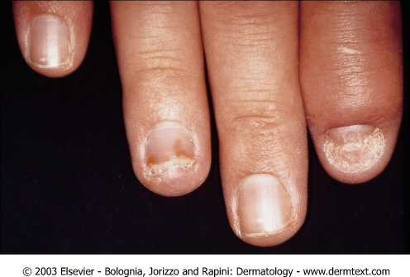

Slide 25
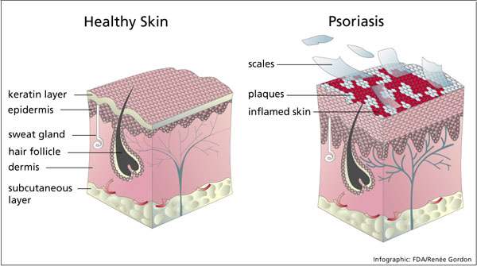
Healthy & psoriasis skin

Slide 26
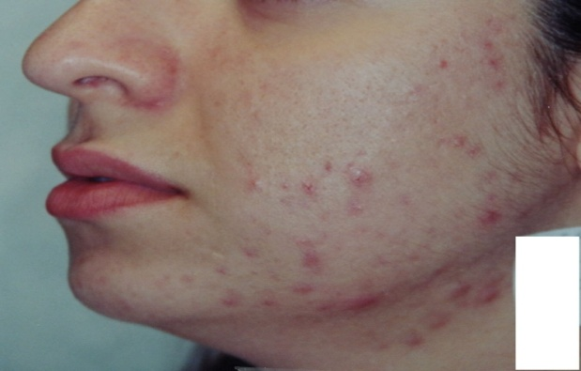
2. Acne vulgaris
Acne is also a skin condition which presents PUSTULES, PAPULES formed by blocking of sebaceous pores & hair follicles affecting mainly the face, chest & back.
The more severe & long lasting forms cause disfiguring & serious distress.
Using UVR is aiming to produce desquamation to open the blocked pores and hair follicles.
E2 dose is given to the face, chest and neck.

Slide 27
3. eczema
It is an INFLAMMATORY RESPONSE in the skin associated with OEDEMA.
The patient suffers marked ITCHING with REDNESS, SCALING, VESCILES & exudation of serum on the skin.
A mild UVR treatment will help. (Sub acute & Chronic stage)

Slide 28
4. Chronic infection & infected wounds
Infected wounds such as
ULCERS
PRESSURE SORES
SURGICAL INCISIONS are often treated with HIGH DOSES of UVR.
The aim of UVR irradiation is to destroy the surface bacteria, remove the (SLOUGH) infected material & promote repair.
E3 dose is sufficient, the dose is may be given daily and is not being applied to normal skin.

Slide 29
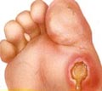
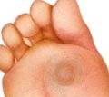
ULCERS

Slide 30
PRESSURE AREAS

Slide 31
INCISIONS

Slide 32
5. VITILIGO
It is a condition in which destruction of MELANOCYTES in local areas causes WHITE PATCHES to appear on the skin.
Both UVA & UVB stimulate melanocyte activity.
UVA seems to provoke a DARKER & LONGER LASTING TANNING.
UVB provokes more THICKENNING.

Slide 33
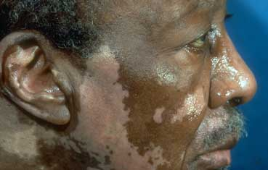
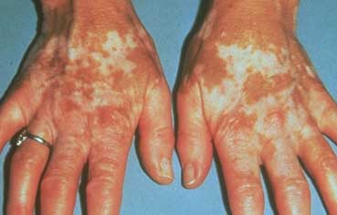
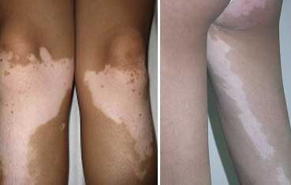

Slide 34
6. NON – INFECTED WOUNDS
The aim of UVR is to stimulate the GROWTH of GRANULATION TISSUE & SPEED UP REPAIR.
UVA stimulates GROWTH.
Example for non infected wounds are – Venous / Arterial ulcers.

Slide 35
7. Counter irritation
It is used to produce a strong counter irritation effect over the site of DEEP SEATED PAIN.
E4 dose is given to cause discomfort and producing mask of pain .

Slide 36
INDICATIONS FOR UVR
1. DERMATOLOGICAL CONDITIONS – Psoriasis, Acne, Sub acute & Chronic Eczema.
2. Calcium / Phosphorus disease – Osteomalacia
3. Non pulmonary tuberculosis
4. Local Ulceration – Ulcers, Pressure sores, Surgical incision

Slide 37
INDICATIONS FOR UVR
5. Upper respiratory condition management – Common Cold.
6. Counter Irritant Effect.

Slide 38
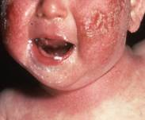
Contraindication of uvr
1. Pulmonary Tuberculosis
2. Severe cardiac disturbances
3. Systemic Lupus Erythematosis
4. Severe Diabetes
5. Dermatological Conditions

Slide 39
Contraindication of uvr
6. Known Photosensitivity.
7. Photosensitizing medication.
8. Deep x – Ray therapy.
9. Acute Febrile illness
10. Recent skin grafts.

Slide 40
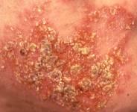
Contraindication of uvr
Hyperthyroidism
Generalized dermatitis
Advanced arteriosclerosis
Acute eczema
Herpes simplex
Hypersensitivity to sunlight
Porphyrias
Pellagra
Sarcoidosis
Xeroderma pigmentosum
Acute psoriasis
Renal and hepatic insufficiencies

Slide 41
dangers
1. Shock
2. Eyes - UVR may produce conjunctivitis, iritis or cataract.
3. Over Dosage – UVR burn can occur. Mainly E4 reaction
4. Ozone – Important to ensure adequate Ventilation in the area.

Slide 42
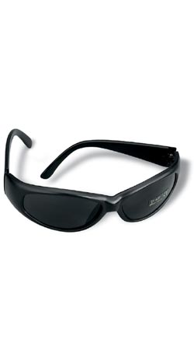
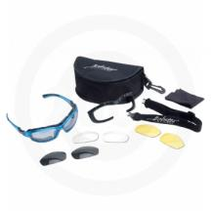
Safety precautions against sunlight(UVR)
1. Eyes protection.

Slide 43
2. Skin damage / tanning protection
Sunscreen doesn’t offer 100% protection.
SPF(Sun Protection Factor) 30+ sunscreen blocks 96% of UV; SPF 15+ blocks out 93%.
In addition to sunscreen, wear a hat, sunglasses, more clothing, and seek shade.

Slide 44
Guidelines for Protection
Tanning Protection

Slide 45
Protective clothing
Most cotton and cotton/polyester fabrics protect against 95% of UV, but are less effective if wet, faded, or aged.

Slide 46
Test dose & determinig med
It is used to assess the individual patients (ERYTHEMAL) reaction to uvr irradiation.
The basis for any calculation of any UVR dosage is the MED (MINIMAL ERYTHEMAL DOSE)
This MED refers to the response of erythema for the dose to be given

Slide 47
Test dose cont….
The patient must understand that the purpose of the MED test is to DETERMINE just how much EXPOSURE TIME is necessary based on their skin sensitivity.
Proper patient education should be given:-
1. Wear Goggles
2. Observe & monitor the skin condition
3. Keep skin moisture following exposure to UVR
4. Pigmentation changes are to be expected & are a normal response.
5. Prolonged & repeated exposure leads to premature aging.

Slide 48
steps to determine test dose / skin test
1. The area chosen for the test is of importance.
2. Because the patient is to inspect at regular intervals a convenient, visible site is essential.
3. It should be clear of skin disease.
4. The FLEXOR SURFACE of the FOREARM is the most usual site.(Other sites are – Abdomen, Medial aspect of arm / thigh)
5. The selected site should be cleaned with soap & water to remove surface grease.
6. Cover the patient other areas leaving only the forearm exposed to UVR.

Slide 49
steps to determine test dose / skin test
7. Three to Five holes of at least 2cm² & 1cm apart are cut in a piece of lint/paper/cardboard is taken for irradiation of UVR along with a slide cover – to pull up to reveal one opening at a time.

Slide 50
steps to determine test dose / skin test
8. This cutting is fixed to the forearm with adhesive plaster.
9. The cuttings are of different sizes & shapes in-order to make IDENTIFICATION OF THE ERYTHEMA EASIER for the patient.
10. Allow the lamp to warm up according to the manufacturer instructions.
11. Place the lamp PERPENDICULAR to the area being tested (Forearm) & a DISTANCE of 60 to 90cms from the site.
12. Expose the 1st opening for 30sec, then expose the
2nd opening for another 30sec & go on till the last opening

Slide 51
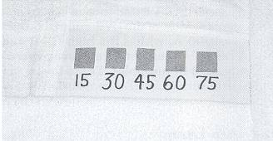
steps to determine test dose / skin test
13. So the 1st opening would receive the longest exposure time & the last opening would receive the least amount of exposure time.
14. Switch off the lamp
15. Instruct the patient to MONITOR the forearm every 2hrs & note which opening or shape appeared pink / red first & when it faded / disappeared.
16. The patient is also given a card similar to the opening to make a note.

Slide 52
mInimal erythemal dose
It is a slight reddening (erythema) of the skin which takes from 6 – 8hrs to develop & which is still just visible at 24hrs.

Slide 53
Description of degrees of erythema
Degree of Erythema | Latent period In HRS | Appearance color | Duration of Erythema | Skin Oedema | Skin discomfort | Desquamation of skin | Relation to E1 Dose
E1 | 6-8 | Mildly pink | <24hrs | None | None | None | E1
E2 | 4-6 | Definite Pink Red. Blanches on Pressure | 2 Days | None | Slight Soreness, Irritation | Powdery | 2.5% of E1
E3 | 2-4 | Very red, Does not blanch on pressure | 3-5 Days | Some | Hot & Painful | In thin Sheets | 5% of E1
E4 | <2 | Angry Red | A Week | Blister | Very Painful | Thick Sheets | 10% of E1

Slide 54
dosage
The skin response to UVR depends on;
1. The quantity of UVR energy applied to unit area of the skin.(Depends on);
The output of lamp – Make, Type, Aging
Distance between the lamp & the skin – Inverse square law
Angle at which radiations fall on the skin – cosine law
Time for which radiations are applied
2. The sensitivity of the skin

Slide 55
CALCULATION OF DOSAGE
E1/MED is the basic of UV calculation which is determined for each individual patient by performing a skin test.
From this point all other doses of UVR can be calculated.
E2 = 2½ x E1
E3 = 5 x E1
E4 = 10 x E1

Slide 56
CALCULATION OF DOSAGE
EXAMPLE:
If the E1 dose of the patient is 25sec, calculate the E3 dose?
E1 dose = 25sec
E3 dose = 5 x E1
E3 dose = 5 x 25 = 125sec

Slide 57
Calculation of new dose
The dose at different distances from the lamp to skin can be calculated by formula;
NEWDOSE = OLD DOSE X NEW DISTANCE²
OLD DISTANCE ²

Slide 58
Progression of dosage
An exposure to UVR should not be repeated until the erythema caused by a previous dose has faded.
Thickening of the epidermis
Necessary to increase the exposure in order to repeat the erythemal reaction at each successive dose
Doses are progressed as follows:
To repeat an E1 25% of the preceding dose is added
To repeat an E2 50% of the preceding dose is added
To repeat an E3 75% of the preceding dose is added
To repeat an E4 100% of the preceding dose is added

Slide 59
Progression of dosage
Examples of progression of dosage
If E1 is 30sec, find the second progression (P2E1)?
E1= 30sec
P1(Day one progression)E1 = E1 + 25% of E1 = 30 +30/4 = 30 + 7.5 =37.5sec
P2(Day two progression) E1 = P1E1 + 25% of P1E1 = 37.5 +37.5/4 = 46.9sec
P2E1 = 47sec

Slide 60
Selection of dosage level
1. An E1/MED – Given to the total body area (Whole body)
2. An E2 - May not be given to up to 20% of total body area
3. An E3 – May not be given to up to 250cm² of normal skin
4. An E4 – May only be given to an area up to 25cm² of normal skin.

Slide 61
Frequency of UVR treatment
1. An E1 / MED may be given DAILY
2. An E2 – Should be given every second day
3. An E3 – Should be given every 3 or 4th day (Twice Weekly)
4. An E4 – may only be given once a week or even once a fortnight.
N.B. when treating non-skin areas such as pressure areas or ulcers, all doses may be given daily as there is no erythema reaction produced.

Slide 62
Sensitization / sensitizing drugs
A number of drugs & some foods in a few patients are known to sensitize patients to the effects of UVR.
Commonly seen sensitizing groups are;
1. psoralens - Sensitizer
2. Sulphonamides - Antibiotic
3. Phenothiazine – Tranquilizer
4. Barbiturates
5. Gold therapy
6. Aspirin & Derivatives

