Slide 1
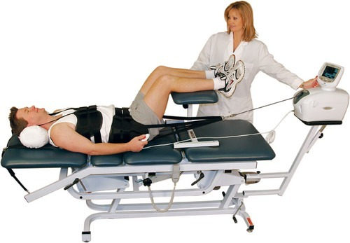
TRACTION
Dr. Mrugnayani
Dept of Sports Physiotherapy
MGM Institute Of Physiotherapy
Chh. Sambhajinagar

Slide 2
Contents
Introduction
Types
Indications and contraindications
Techniques
Effects and uses

Slide 3
Traction
Traction is the technique in which a tractive force is applied to a part of the body to stretch soft tissues and separate joint surfaces or bony segments.

Slide 4
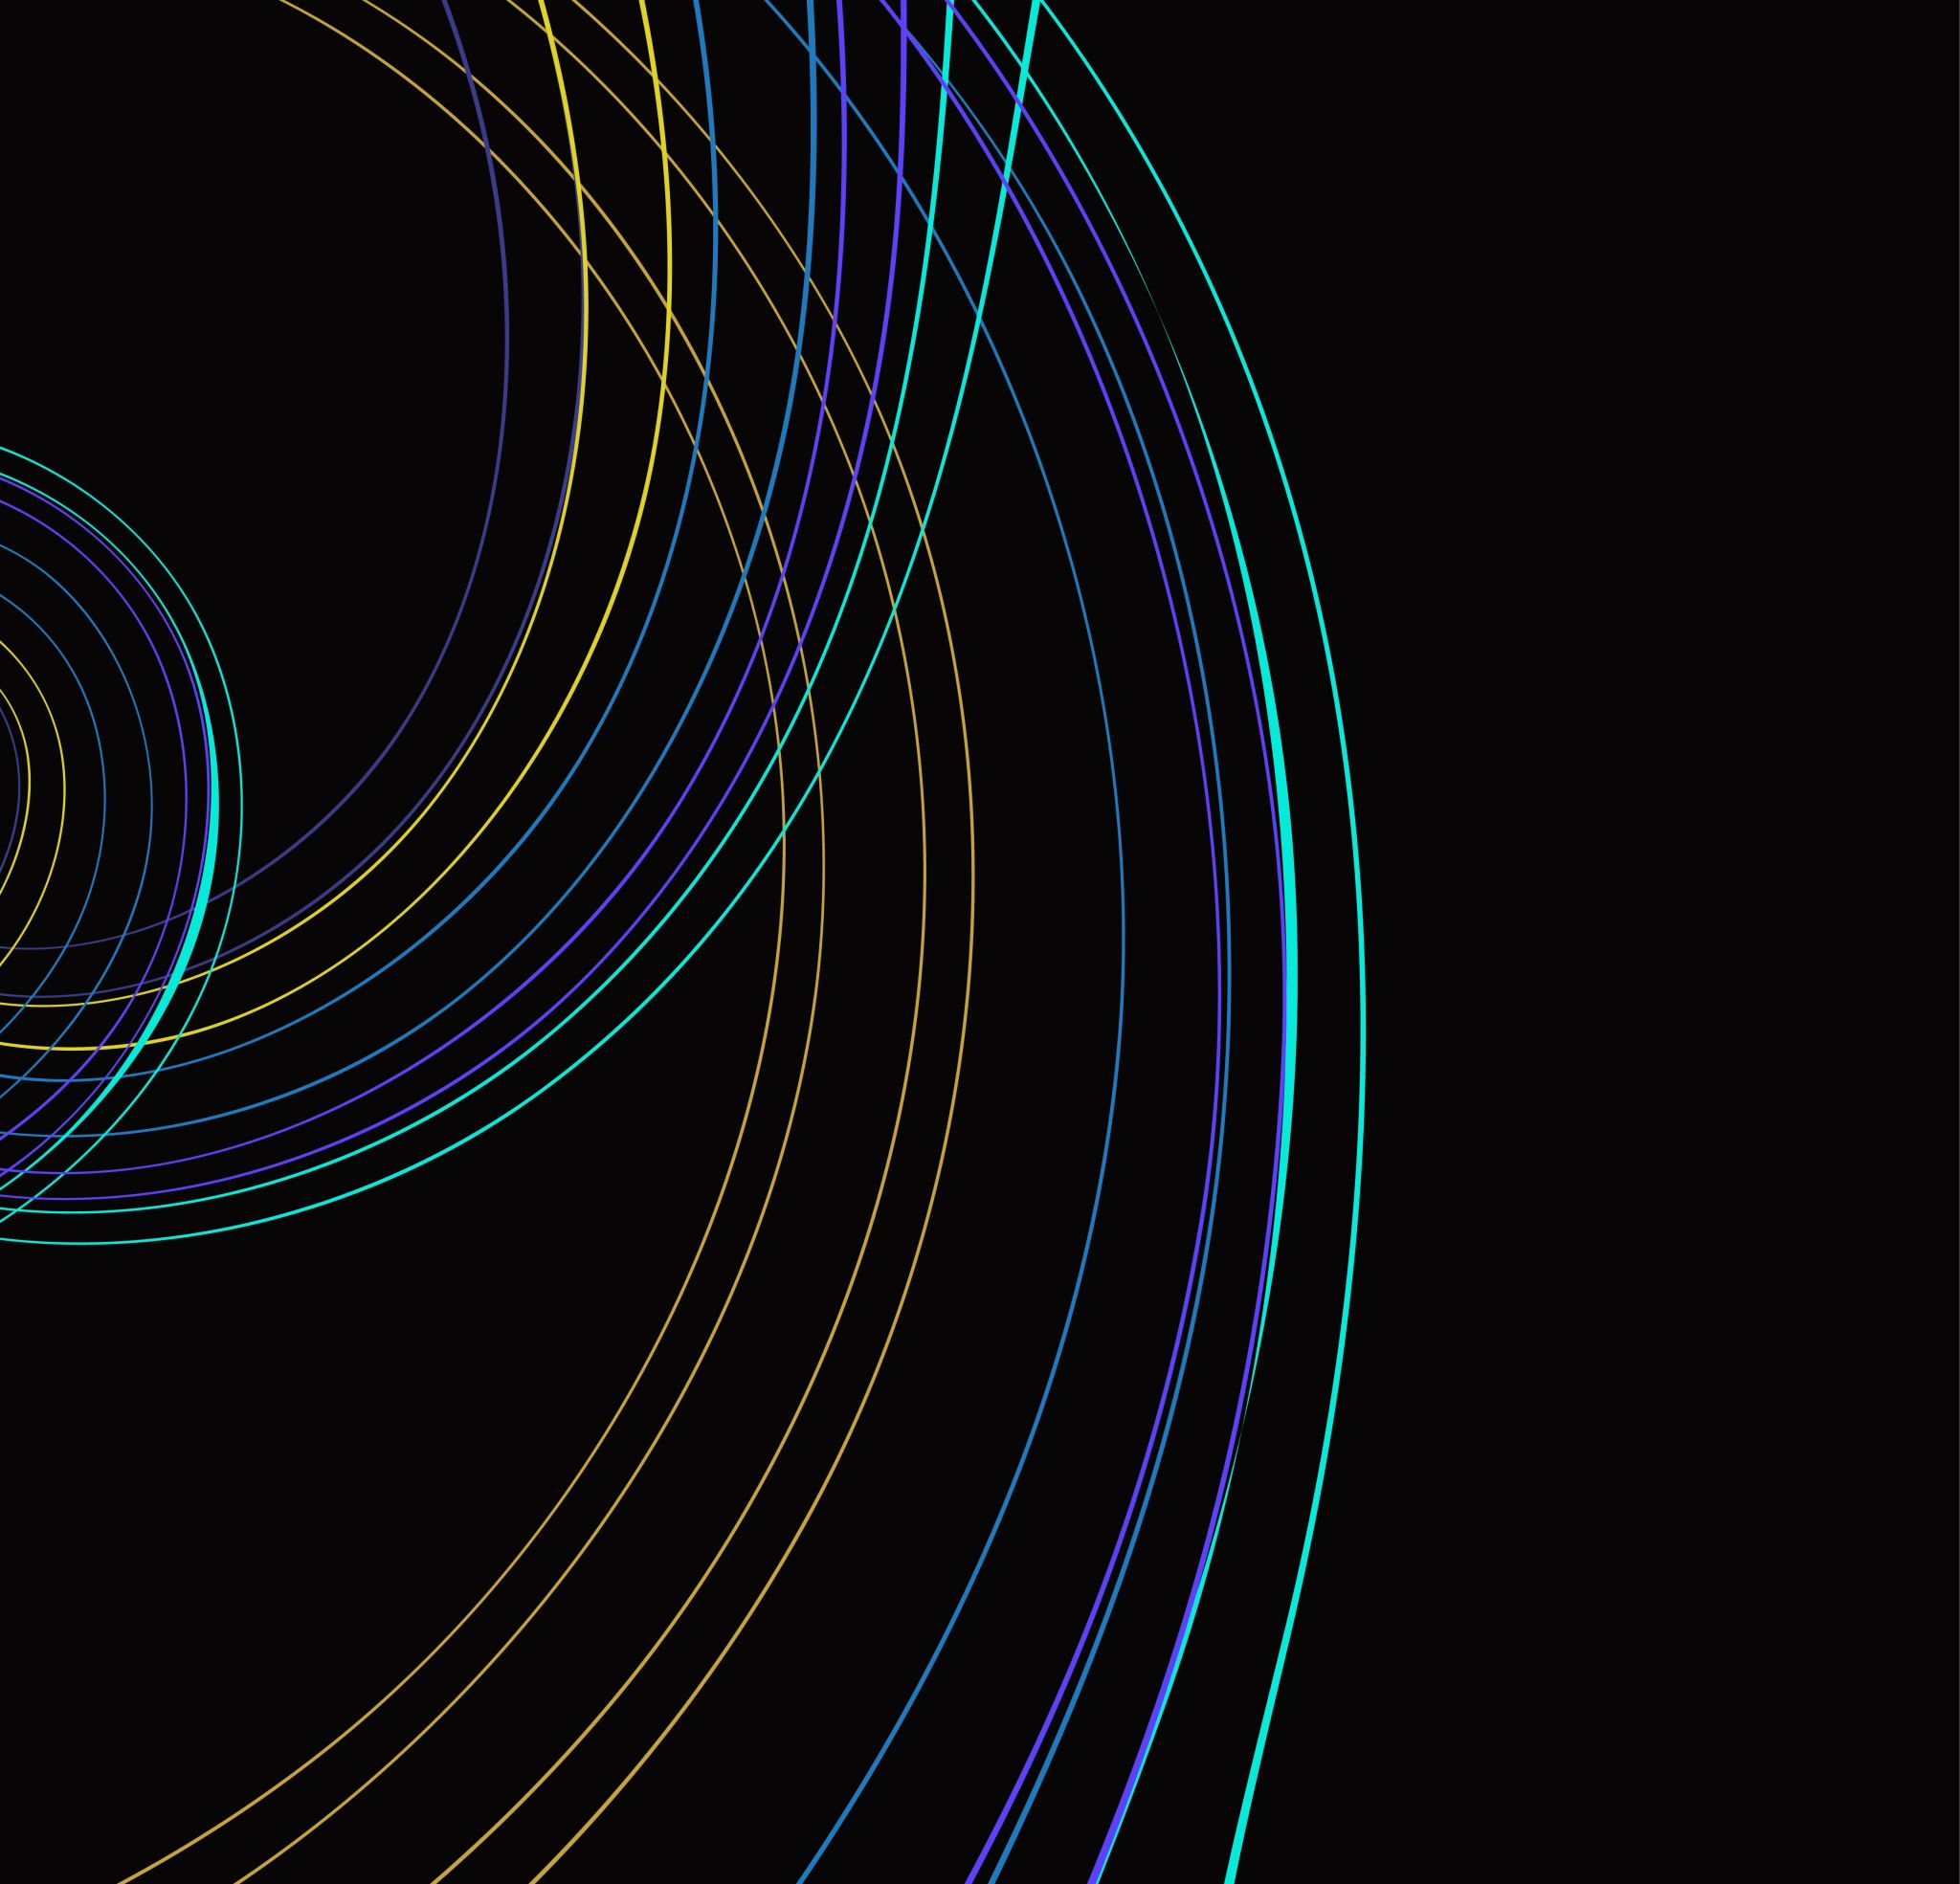
Principles of traction:
1.A force of sufficient magnitude and duration must be exerted. Direction of tractive force may be vertical or horizontal or angle.
2. A magnitude of the tractive force is dependent on the frictional or surface resistance to traction, and resistance to stretch of musculature and soft tissues.3.
3.During traction movement of the body by tractive force must be resisted by an equal and opposite force.
Eg: In vertical traction- wt of the pt act as counterforce
In horizontal traction- tractive force b/w pts body surface & couch.

Slide 5
4. Separation of jt surface is also resisted by muscles and other soft tissues surrounding the joints.
So tractive force sufficient to overcome this additional resistance to stretch by distraction of jt surfaces can take place.

Slide 6
CLASSIFICATION OF TRACTION :
According force:
a.Continued – Low tractive force
- 20-40 hrs
b.Sustained – 20 mins to 1 hr
c.Intermittent – max wt
According to nature:
a.Mechanical
b. Manual
c. Positional
d.Gravitational
e. Auto traction

Slide 8
Types of Traction
• Continuous
– Tx applied for several hours at a time
– Constant tension
– Limited weight tolerated due to long duration
– Ineffective in creating separation
– Normally applied with suspended weights

Slide 9
Types of Traction
• Sustained (static)
– Traction applied with constant tension for several minutes up to ½ hour
– May be applied via suspended weights or a mechanical device

Slide 10
Types of Traction
• Intermittent Mechanical
– Traction applied via a mechanical device with tension alternately applied and then released
– Termed as hold and rest
– Hold and rest times usually vary from a few seconds up to 1 minute

Slide 11
Types of Traction
• Manual
– Tx applied by the therapist grasping the patient and utilizing his or her own force to create traction
– May be applied for a several second hold or as a quick thrust
– Limited by strength and endurance of the therapist
– Very accommodating and provides feedback
– Some possible apprehension by patient

Slide 12
Types of Traction
• Positional
– Tx applied by use of gravity and positioning to effect spinal structures with minimal intervention
– Utilizes pillows, blocks, bolsters
– Normally has a unilateral effect

Slide 13
Types of Traction
• Gravity
– Tx utilizing the force of gravity acting on the patients body weight to effect spinal structures
– 2 types:
• Vest that suspends the lower body by exerting pressure on the rib cage
• Boots that attach to a rod at the ankles with patient in inverted position

Slide 14
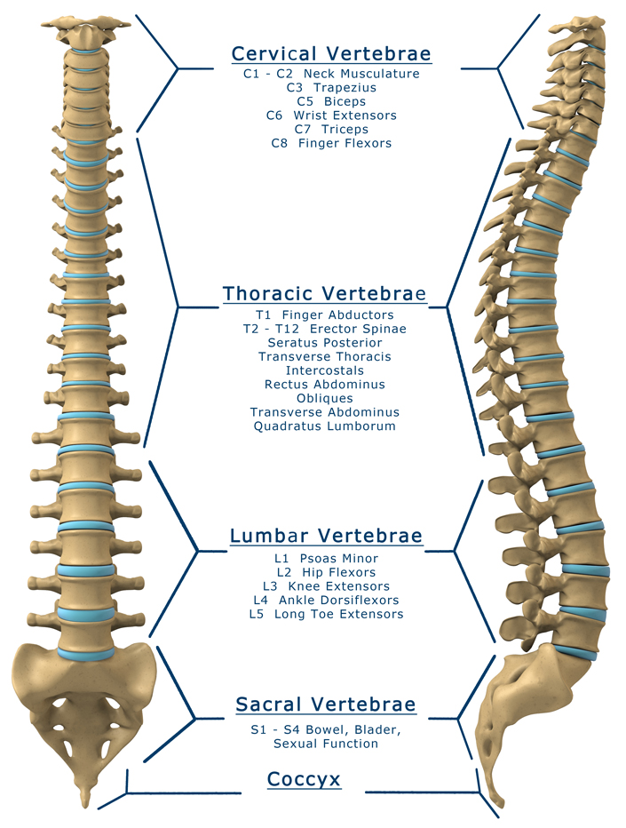

Slide 15
Treatment Indications
• Disc herniation
– In an erect posture the disc helps to dissipate compressive forces
– With movement into flexion/extension/lateral flexion, the pressure changes

Slide 16
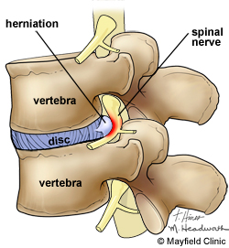
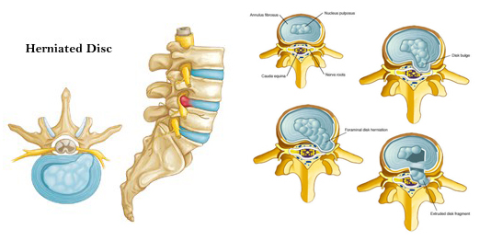
;p000

Slide 17
Treatment Indications
• Nucleus pulposus does not move
– With rupture of the annulus fibrosis the nucleus is allowed to move out of the intervertebral space
– Increases space available, creates suction force, and allows fluid exchange to get rid of waste and allow in fresh nutrients
– Effects are transient

Slide 18
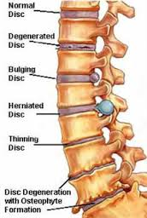
Treatment Indications
• Degenerative disc disease
– Narrowing of intervertebral spaces
– Pressure on nerve roots, increased load on facets
– Traction widens space and decreases pressure temporarily
– May result in realignment that decreases pressure

Slide 19
Treatment Indications
• impinged capsule
• Joint hypomobility
– Mobilization, passive joint movement, non-specific
– Pain control
by synovial fluid exchange to facet capsules and the meniscus for nutrition, and
proprioceptive response from moving facet structures gives a gate control response

Slide 20
Treatment Indications
• Nerve root impingement
– From bulging disc, osteophytes (spurs), narrowed foramen
– Tingling usually associated with nerve compression
– Continued pressure gives demyelination with slowing of nerve impulses and can progress to axon death with resulting numbness, weakness and diminished reflex responses
– Muscle spasms may develop in paraspinals with the same innervation level

Slide 21
Widens foramen
– May need unilateral or rotation added
– May realign to decrease pressure
– Decreases spasms that may be the cause of compression
– Nerve irritation can cause muscle spasms as the root levels may be the same, just different axons

Slide 22
Treatment Indications
• Muscle tightness, spasms
– Stretches, inhibits
– Decreases load on other structures (nerve root, facets, disc) that may result in spasms
– Fluid exchange
– Initial stretch should come form positioning
– EMG activity will decrease with proper technique, increase with improper

Slide 23
Treatment Indications
• Scoliosis
– Pulls towards a more correct alignment
– Stretches out tight musculature or other joint structures
• Pain
– Traction may decrease pressure on sensitive structures and give a gate control effect with movement of these structures

Slide 24
Contraindications
• Acute conditions
– Tx to acute sprains and strains may overwhelm already weakened soft tissue
• Already weakened soft tissue
• Joint instability
– hypermobility
• Structural disease secondary to infection, tumor, etc.
• Vascular compromise
• Fractures
• Tumors
• Bone disease or infection
• Cardiac conditions

Slide 25
Relative Contraindications
• Pregnancy
• Osteoporosis
• Hiatal hernia
• Claustrophobia

Slide 26
General Technique for Applying Lumbar Tx
• Force must be great enough to effect change to the target structure
– 20-50% to move body
– Coefficient of friction is about 0.5
– Usually attempt to move 50% of the patient’s body weight
– 65-100 lbs of force to separate vertebrae on average
• May not be necessary for all treatments (spasms, pain)
• May not get to 65-100 lbs on first treatment
– Split table to reduce friction, must separate at target tissue
– Damage not reported until somewhere in the 400-800 lb range
– Instability is a problem with the sedentary, weak, elderly, and young

Slide 27
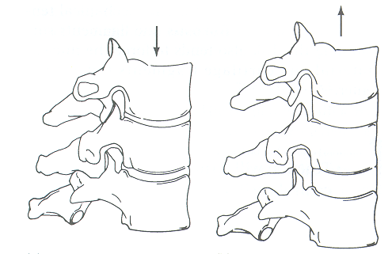
Effects of Traction: Spine
Encourages movement between each individual spinal segment
Amount of movement varies according to…
Position of spine,
Amount of force, and
Length of time the force is applied
Transient effect

Slide 28
Effects of Traction: Spine
↓ pain, paresthesia, or tingling
Due to physical separation of vertebral segments thus decreasing pressure on sensitive structures
As long as positive physiologic effects occur, traction should be continued

Slide 29
Effects of Traction: Bone
No immediate effects due to traction
May result in increased spinal movement that reverses bone weakness associated with immobilization
May assist with increasing or maintaining bone density

Slide 30
Effects of Traction: Ligaments
Stretching effect
Structural changes occur slowly due to viscoelastic properties
Ligaments resist shear forces and return to original form following removal of a deforming load
Sensitivity to rate of loading
Ligament deformation results in lengthening of a ligament caused by traction loading
Slow loading rates allow for more deformation

Slide 31
Effects of Traction: Disks
Normal disk in non-compressed position
Internal pressure (indicated by arrows) is exerted equally in all directions
Internal annular fibers contain nuclear materials

Slide 32
Effects of Traction: Disks
In an injured disk, sitting or standing compresses the disk causing the nucleus to become flatter
Pressure in this instance still remains relatively equal in all directions

Slide 33
Effects of Traction: Disks
In an injured disk, movement in weight-bearing causes a horizontal shift in nuclear material
If this was forward bending, the bulge would occur in the posterior annular fibers
Anterior annular fibers would be slackened and narrow

Slide 34
Effects of Traction: Disks
Herniation of the nuclear material occurs if the annular wall becomes weak
Herniation may possibly put pressure on sensitive structures in the area

Slide 35
Effects of Traction: Disks
When placed under traction, intervertebral space expands thereby decreasing pressure on the disk
Taut annular fibers create a centripetally directed force
Decreases herniation and pressure on sensitive structures in the area

Slide 36
Effects of Traction: Articular Facet Joints
Facet joints are separated releasing impinged structures
Dramatic reduction in symptoms
Joint separation decompresses articular cartilage allowing synovial fluid exchange to nourish cartilage
Decreases rate of degenerative changes
Increased proprioception from facet joint structures provide sensation of pain relief

Slide 37
Effects of Traction: Muscles
Vertebral muscles can be stretched
Initial stretch should come from body positioning
Stretch lengthens tight muscle
Allows for better muscular blood flow
Activates muscle proprioceptors providing sensation of pain relief
Gate Control Theory

Slide 38
Effects of Traction: Nerves
Focus of most traction treatments
Pressure on nerves or nerve roots often associated with spinal pain
Unrelieved pressure on a nerve will cause
Slowing, eventual loss of impulse conduction
Motor weakness, numbness, and loss of reflex
Pain, tenderness, and muscular spasm

Slide 39
Cervical Traction
Application of a longitudinal force to the C-spine & structures
Tension applied can be expressed in pounds or % of patient’s body weight.
At 7% of patient’s body weight, vertebral separation begins
Human head accounts for ≈8.1% of body weight (8-14 lbs.)
Greater amount of force is needed widen areas
You want force to be about 20% of body weight

Slide 40
Cervical Traction Positioning
Seated – a greater force is needed to apply the same pressure (due to gravity) than if supine
Supine – support lumbar region (bend knees, use knee elevator, or hang lower legs over end of table & place feet on chair); allows musculature to relax

Slide 41
Effects of Cervical Traction
Reduces pain & paresthesia associated w/ n. root impingement & m. spasm
Reduces amount of pressure on n. roots & allows separation of vertebrae to result in decompression of disks.

Slide 42
Effectiveness of Cervical Traction
Cervical traction has been linked to 5 mechanical factors
Position of the neck
Force of applied traction
Duration of traction
Angle of pull
Position of patient

Slide 43
Cervical Treatment Set-up
Neck – placed in ≈25-30° flexion
Straightens normal lordosis of C-spine
Must have at least 15° flexion to separate facet joint surfaces
Body must be in straight alignment
Be aware that C-spine traction can cause residual lumbar n. root pain if improperly set up.
Duration – 10-20 minutes most common

Slide 44
Cervical Treatment Set-up
Remove any jewelry, glasses, or clothing that may interfere
Lay supine, place pillows, etc. under knees
Secure halter to cervical region placing pressure on occipital process & chin (minor amount)
Align unit for 25-30° of neck flexion
Remove any slack in pulley cable
On:Off sequence 3:1 or 4:1 ratio

Slide 45
Cervical Treatment
Following treatment, gradually reduce tension & gain slack
Have patient remain in position for a few minutes after treatment

Slide 46
Lumbar Traction
To be effective, lumbar traction must overcome lower extremity weight (¼-½ of body weight)
Friction is a strong counterforce against lumbar traction
Split table is used to reduce friction

Slide 47
Lumbar Traction
Mechanical traction
Motorized unit
Self-administered Autotraction
Manual traction
Belt
Thoracic stabilization harness
Pelvic traction harness
Clinician’s body weight

Slide 48
Lumbar Traction
Tension
Approximately ½ of body weight
Published literature = 10-300% of patient’s body weight
Patient Position & Angle of Pull
Should maximize separation & elongation of target tissues
Prone or Supine – depends on:
Patient comfort
Pathology
Spinal segments & structures being treated

Slide 49
Lumbar Traction - Patient Position
Supine positioning
Tends to increase lumbar flexion
Flexing hips from 45° to 60° increases laxity in L5-S1 segments
Flexing hips from 60° to 75° increases laxity in L4-L5 segments
Flexing hips from 75° to 90° increases laxity in L3-L4 segments
Flexing hips to 90° increases posterior intervertebral space
Prone Position
Used when excessive flexion of lumbar spine & pelvis or lying supine causes pain or increases peripheral symptoms

Slide 50
Lumbar Traction – Angle of Pull
Anterior angle of pull increases amount of lumbar lordosis
Posterior angle of pull increases lumbar kyphosis
Too much flexion can impinge on the posterior spinal ligaments
Optimal position & angle of pull –
Often derived by trial & error
Depends on patient & pathology of injury

Slide 51
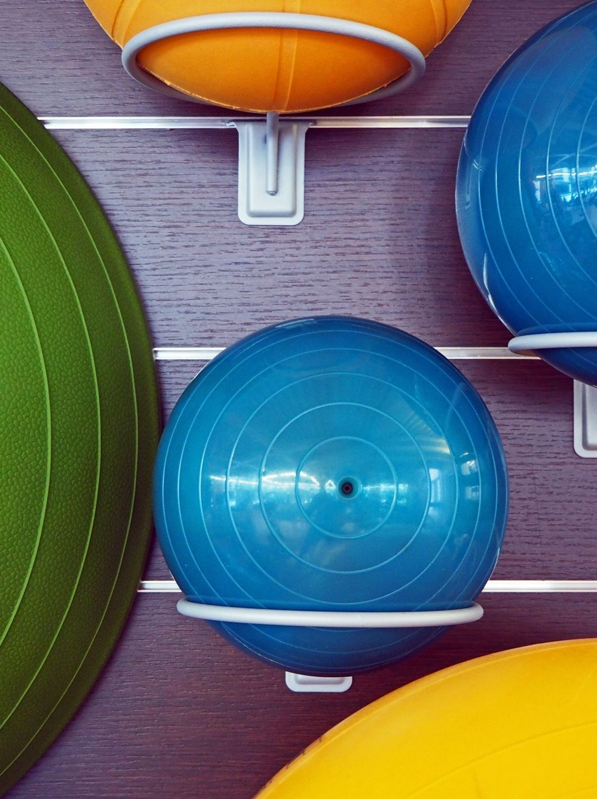
Lumbar Treatment Set-up
Calculate body weight
Apply traction & stabilization harness
Position on table, drape for modesty
Set mode – intermittent or continuous
Set ON:OFF ratio time
Set tension
Set duration
Give patient Alarm/Safety switch
Explain everything to patient prior to beginning treatment!

