Slide 1
Hereditary Motor Sensory Neuropathy

Slide 2
Definition
Hereditary motor sensory neuropathy (HMSN) or Charcot-Marie-Tooth Disease (CMTD), is a group of inherited, progressive, motor and sensory peripheral nerve disorders with demyelination, axonal degeneration, or both
Symmetrical / slow progressive distal motor neuropathy
1st to 3rd decade
Distal muscle weakness and atrophy, weak ankle dorsiflexion, depressed tendon reflexes, and pes cavus foot deformity (i.e., high-arched feet).

Slide 3
Etiology
More than 80 different genes are associated with CMT
Modes of inheritance include autosomal dominant, autosomal recessive, X-linked recessive, and X-linked semi-dominant

Slide 4
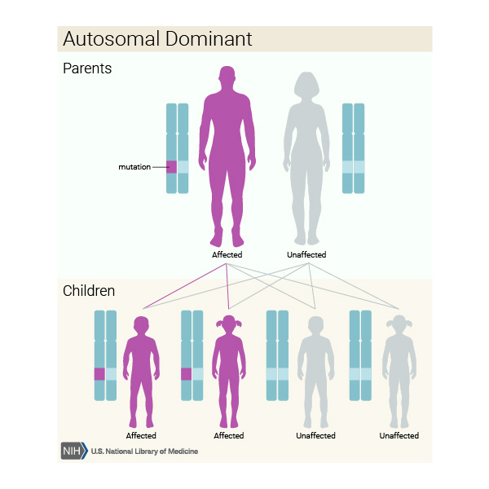
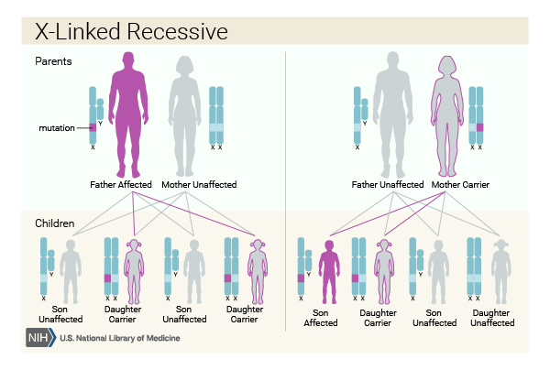
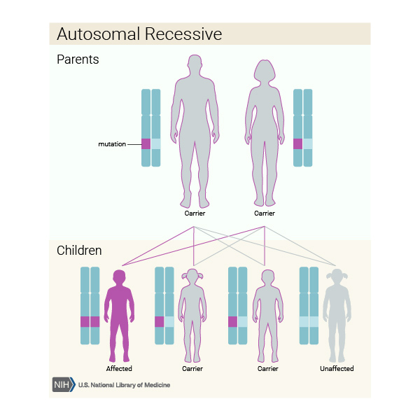
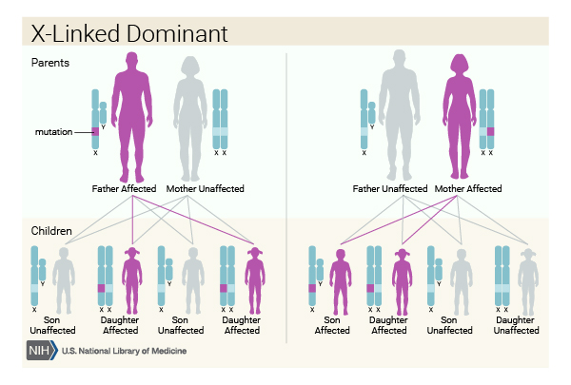

Slide 5
Epidemiology
HMSN is the most common inherited neuromuscular disease with overall prevalence of approximately 1/2500 and incidence 15/100,000 in the general population.
Frequency of some subtypes varies with ethnicity.
Risk factors are family history for autosomal dominant or X-linked forms, and consanguinity for autosomal recessive ones.
Primary prevention is genetic counseling.

Slide 6
Classification
CMT1 = primarily demyelinating(about 50%)
CMT2 = primarily axonal (1/5th of cases)
CMTX = X-linked, most with both demyelinating and axonal features.(10-12%)
CMT4 = autosomal recessive, typically more severe, early onset, may be demyelinating, intermediate, or axonal
CMT 3= Dejerine-Sottas disease - axonal degeneration or demyelination

Slide 7
Clinical Features
Muscle weakness is often associated with mild to moderate distal sensory loss.
Although usually described as "painless," the neuropathy can be painful
Sensory loss - demonstrated by a decreased appreciation of vibration, impaired sensation of pain/pinprick, temperature, and joint position.
Sensorineural hearing loss
The clinical diagnosis of CMT in a symptomatic person is based on characteristic findings of peripheral neuropathy on medical history and physical examination.

Slide 8
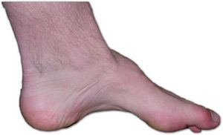
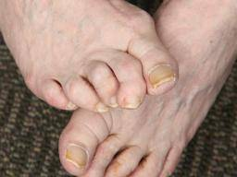
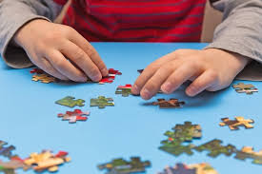
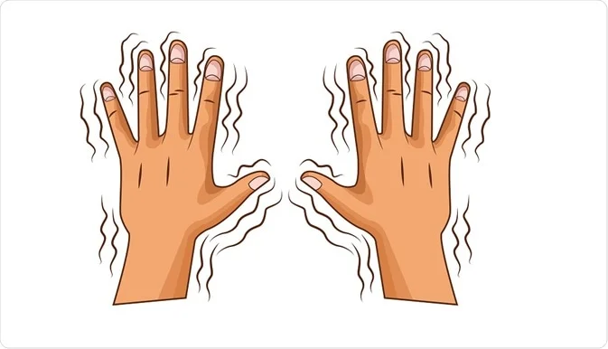
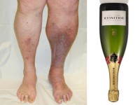
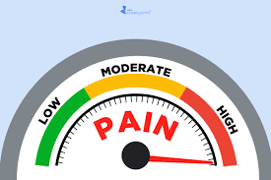
Signs & symptoms
Notes:
1,clumsy walk 2. Pes cavus 3. Hammer toes 4,inverted champagne bottle 5 .loss fine mvts& dexterity 6.pain 7. Tremors

Slide 9
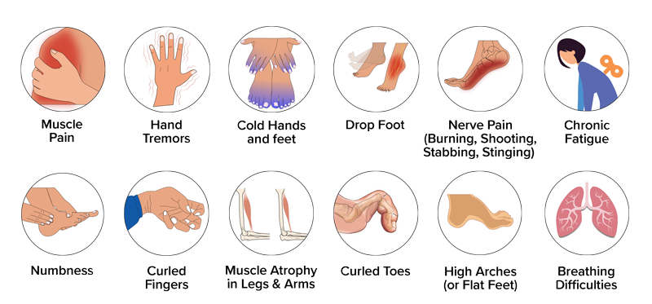

Slide 10
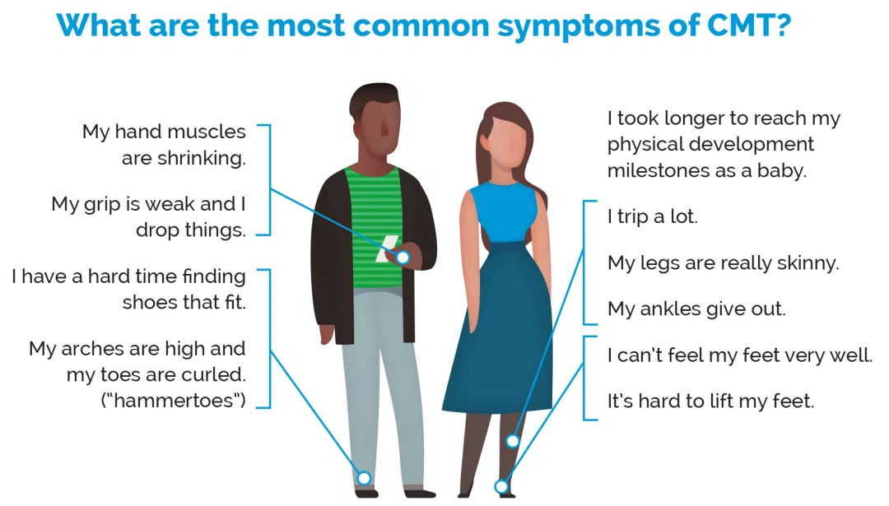

Slide 11
Medical Management
Supportive therapy
Deformity correction Surgery -(soft tissue surgeries, osteotomies and arthrodesis)
Physiotherapy & Occupational therapy
Orthotic Advices
Hydrotherapy
Aerobic exercises
Stretching (PNF)
Balance & Posture
Functional Training

Slide 12
In light of Evidence
Treatment is symptomatic. Affected individuals are often evaluated and managed by a multidisciplinary team that includes neurologists, physiatrists, orthopedic surgeons, and physical and occupational therapists [Grandis & Shy 2005, McCorquodale et al 2016].
Quality of life and defining disability have been measured and compared among various groups of individuals with CMT [Burns et al 2010, Ramchandren et al 2015]. Persistent weakness of the hands and/or feet has important career and employment implications; anticipatory counseling is appropriate.

Slide 13
Special shoes, including those with good ankle support, may be needed. Affected individuals often require ankle/foot orthoses (AFOs) to correct foot drop and aid walking. Night splints have not improved ankle range of motion [Refshauge et al 2006, Kenis-Coskun & Matthews 2016].
Some individuals require forearm crutches or canes for gait stability; fewer than 5% of individuals need wheelchairs.
Daily heel cord stretching exercises to prevent Achilles tendon shortening are desirable, as well as gripping exercises for hand weakness [Vinci et al 2005b].
Exercise is encouraged within the individual's capability and many individuals remain physically active [Sman et al 2015].

Slide 14
Orthopedic surgery may be required to correct severe pes cavus deformity [Guyton 2006, Casasnovas et al 2008, Ward et al 2008]. Surgery is sometimes required for hip dysplasia [Chan et al 2006].
The cause of any pain should be identified as accurately as possible [Padua et al 2006].
Musculoskeletal pain may respond to acetaminophen or nonsteroidal anti-inflammatory agents [Carter et al 1998].
Neuropathic pain may respond to tricyclic antidepressants or drugs such as carbamazepine or gabapentin.
Modafinil has been used to treat fatigue [Carter et al 2006].
Periodic monitoring by specialists in otolaryngology to detect vocal cord hypomotility and quantify the degree of airway obstruction, a potentially lethal complication [Zambon et al 2017].

Slide 15
let's look at

Slide 16
References
Randall L braddom
https://www.ncbi.nlm.nih.gov/books/NBK1358/
https://now.aapmr.org/hereditary-motor-sensory-neuropathy-hmsn/
Notes:
https://www.physio-pedia.com/Charcot-Marie-Tooth_disease

Slide 17
Thank you

