Slide 1
SPONDYLOSIS
Dr. Goutami Katage Shah
Dept. Of Musculoskeletal Physiotherapy
MGM Institute Of Physiotherapy
Chh. Sambhajinagar

Slide 2
CONTENTS
Definition
Causes
Pathology
Clinical features
Investigations
Management

Slide 3
Definition
It is degenerative condition seen in cervical and lumbar spine
Seen over 50 years of age
Characterized by insidious onset
Spondylosis, also known as spinal osteoarthritis, can affect the lumbar, thoracic, and/or the cervical regions of the spine. Although aging is the primary cause, the location and rate of degeneration is individual.

Slide 4
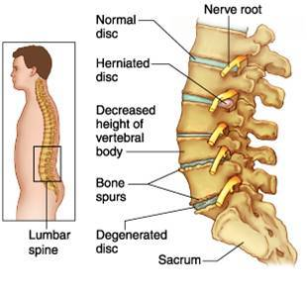

Slide 5
PATHOLOGY
Pathology begins in the IV Disc
Leading to degeneration od disc- reduction in disc space
Peripheral osteophyte formation
Degeneration seen also in posterior joints
Osteophte formation may enroach the nerve root canal –nerve involvement

Slide 6
As the lumbar discs and associated ligaments undergo aging, the disc spaces frequently narrow. Thickening of the ligaments that surround the disc and those that surround the facet joints develops.
These ligamentous thickening may eventually become calcified. Compromise of the spinal canal or of the openings through which the spinal nerves leave the spinal canal can occur.
Spondylosis often affects the lumbar spine in people over the age of 40. Pain and morning stiffness are common complaints.

Slide 7
CLINICAL FEATURES
Pain and stiffness
Worse during activity but later present all the time
Radiating pain
Paraesthesia

Slide 8
Cervical spine
Occipital headache- due to alteration in biomechanics
Giddiness- VBI symptoms
Limitation in the neck movements
Loss of cervical lordosis
Spasms
Weakness
Loss of balance

Slide 9
Lumbar spine
Backache
Tingling
Muscle weakness ‘
Tenderness
Stability altered

Slide 10
Usually multiple levels are involved (eg, more than one vertebrae). The lumbar spine carries most of the body’s weight. Therefore, when degenerative forces compromise its structural integrity, symptoms including pain may accompany activity.
Movement stimulates pain fibers in the annulus fibrosus and facet joints. Sitting for prolonged periods of time may cause pain and other symptoms due to pressure on the lumbar vertebrae. Repetitive movements such as lifting and bending (eg, manual labor) may increase pain.
Lumbar spondylosis encompasses lumbar disc bulges, herniations, facet joint degeneration, and vertebral bony overgrowths (osteophytes). Degenerative changes, including osteophyte formation, increase with age but are often asymptomatic.

Slide 11
CAUSES
Degeneration
Disc lesions
Injury
Posture
Age
Obesity
Strenous Physical activity

Slide 12
INVESTIGATIONS
X Ray- Narrowing of IV disc
Osteophyte formation
Narrowing of joint space
Subluxation

Slide 13
PT Management
Spontaneous remissions and exacerbations
Acute stage-
Rest | Hot fermentation | analgesics | Cervical collar / lumbar corset

Slide 14
GOALS????????

Slide 15
Manual Therapy Techniques For The Lumbar Spine and cervical spine
Mckenzie Method
TENS
Yoga
Lumbar Back Support: Can be beneficial for patients suffering from chronic LBP. It occurs to limit spine motion, stabilize, correct deformity and reduce mechanical forces. There is no consensus if it may function as a placebo or really improve pain and functional ability

Slide 16
Contents of Back School ( four 45-min sessions during a 2-week period)
Anatomy and causes of LBP
Function of the muscles and exercise
Ergonomics
Advice on physical activity
One individual session of pool exercises under the supervision of a physiotherapist and an analysis of the working condition by a physiotherapist

Slide 17
Postural training
Taping
Lumbar stability exercises
Lifestyle modification

Slide 18
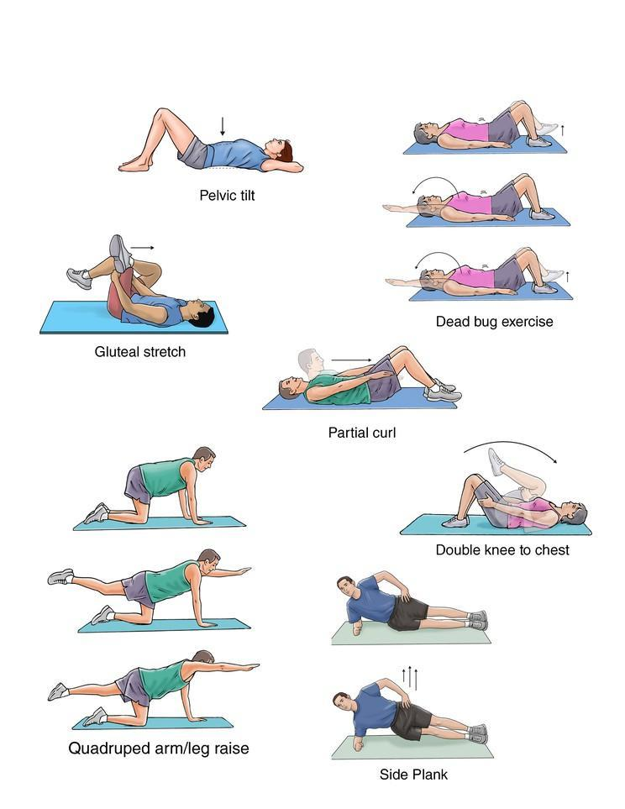

Slide 19
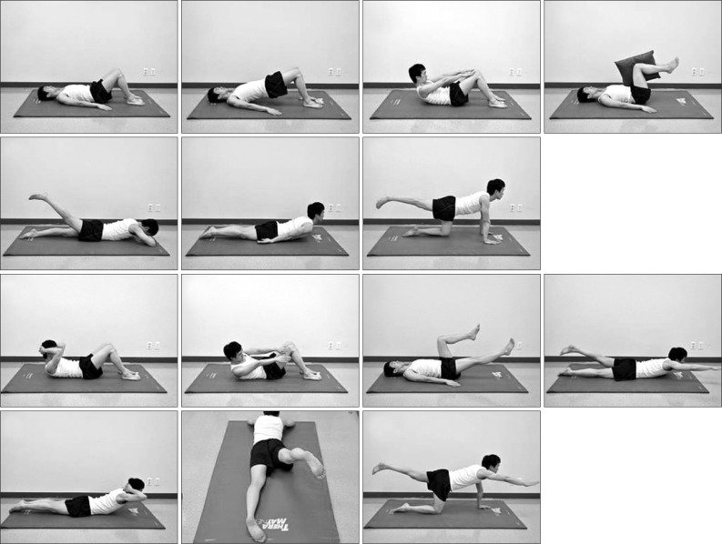

Slide 20
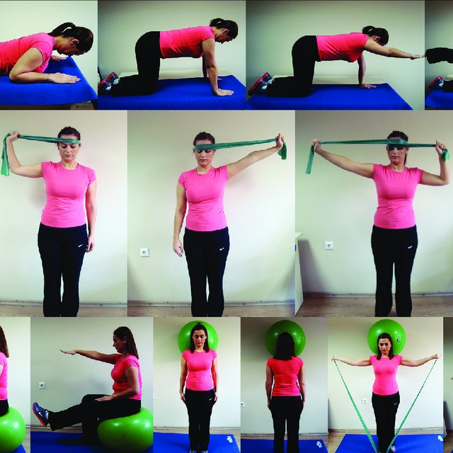

Slide 21
