Slide 1
SPONDYLOLYSIS
Dr. Goutami Katage Shah
Dept. Of Musculoskeletal Physiotherapy
MGM Institute Of Physiotherapy
Chh. Sambhajinagar

Slide 2
Contents
Definition
Causes
Pathophysiology
Clinical features
Investigations
Management

Slide 3
Spondylolysis is defined as a defect or stress fracture in the pars interarticularis of the vertebral arch.
occur in the lower lumbar vertebrae (L5), also occur in the cervical vertebrae.
CAUSES
1. Hereditary
2. Male > females
3. Strenous activities at younger age
4. Repetitive hyperextension and rotation injuries
5. Repetitive trauma and inherent genetic weakness

Slide 4
Separation of the pars interarticularis occurs when spondylolysis is present in the spinal column.
Spondylolysis is typically caused by a stress fracture of the bone, and is especially common in adolescents who over-train in activities.
The pars interarticularis is vulnerable to fracture during spinal hyperextension, especially when combined with rotation
individuals with spondylolysis will develop spondylolisthesis, which is true for 50-81% of this population.

Slide 5
Clinical features
In majority of cases, spondylolysis presents asymptomatically which can make diagnosis both difficult and incidental.
Clinical Signs:Pain on completion of the stork test(placed in hyperextension and rotation)
Excessive lordotic posture
Unilateral tenderness on palpation
Visible on diagnostic imaging (Scottie dog fracture)

Slide 6
Symptoms-
Unilateral low back pain
Pain that radiates into buttocks and legs
Onset of pain acute or gradual
Pain that worsens with daily activities
Pain aggarvated with lumbar hyperextension

Slide 7
INVESTIGATIONS
Bone scintigraphy - If there is a black spot in the lumbar vertebrae (e.g. L5) this indicates damage and potentially spondylolysis. If this test is positive, a CT scan is usually ordered to confirm spondylolysis
CT
MRI

Slide 8
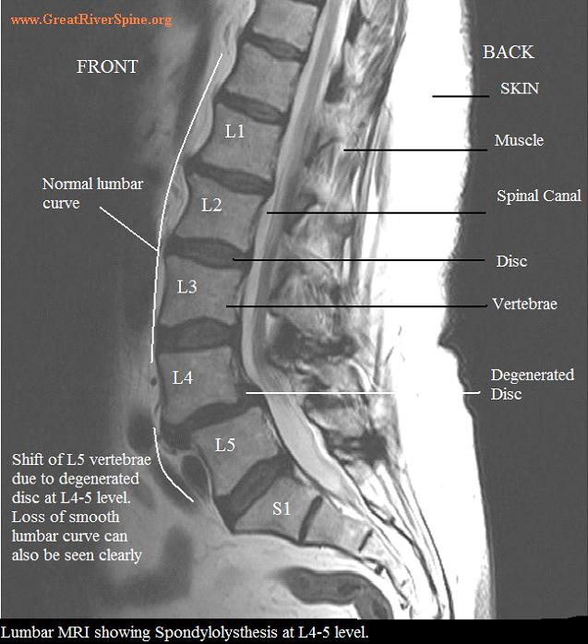

Slide 9
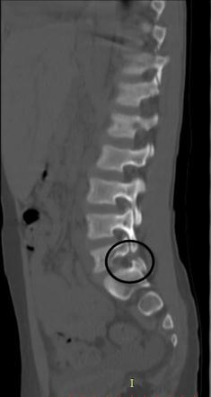
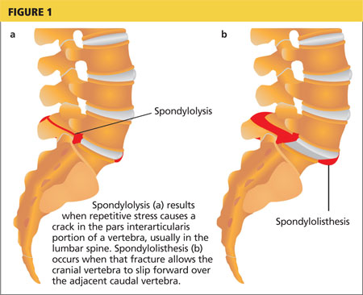

Slide 10
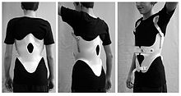
BRACING – Anti lordotic lumbosacral brace
Activity limitation
Strengthening ex
Stability ex

Slide 11
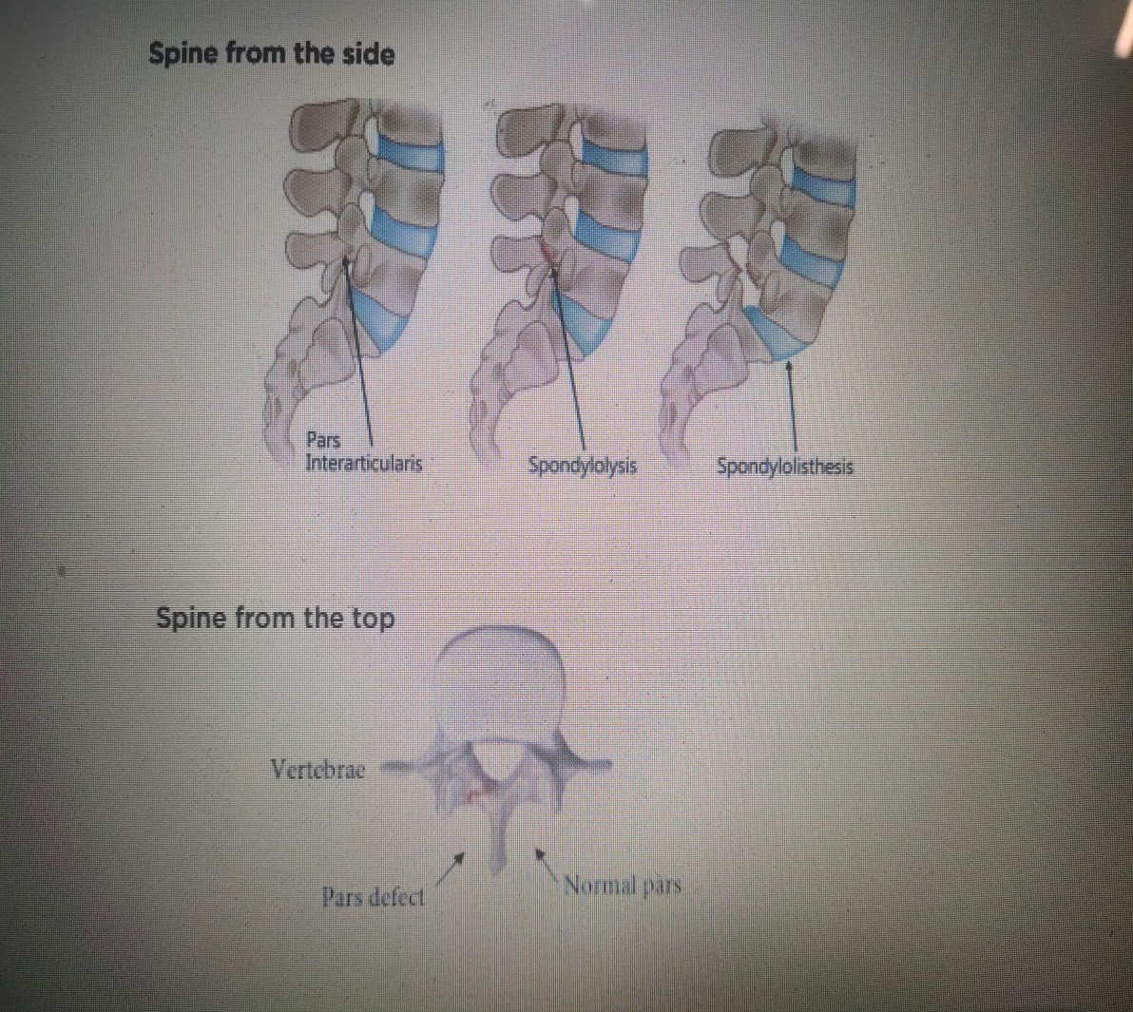

Slide 13
