Slide 1
SPONDYLOLISTHESIS
Dr. Goutami Katage Shah
Dept. Of Musculoskeletal Physiotherapy
MGM Institute Of Physiotherapy
Chh. Sambhajinagar

Slide 2
SPONDYLISTHESIS
Spondy- spine
Listhesis- to slip
Definition- Spondylolisthesis is the slippage of one vertebral body with respect to the adjacent vertebral body causing mechanical or radicular symptoms or pain.
Spondylolisthesis most commonly occurs in the lower lumbar spine but can also occur in the cervical spine

Slide 3
Pathology
This pathology involves
A fractured pars interarticularis of the lumbar vertebrae, also called the isthmus.
This affects the supporting structural integrity of the vertebrae, which could lead to slippage of the vertebrae, called spondylolysthesis.
In turn, leads to one of the most obvious manifestations of lumbar instability

Slide 4
DEGENERATIVE
1. This is due to long standing inter segmental instability .
2. Pars is intact
3. Facetal joint degeneration and remodeling of the facets
4. The resulting weakness in the area can lead to movement and slipping of the spinal vertebrae, and the pathogenesis of spondylolisthesis.
Common, particularly among older individuals.
Women older than 50 years are the most likely to be affected by this type of the condition

Slide 5
TRAUMATIC
1.This category is quite rare and occurs when there are acute fractures in the neural arch. (Note: this does not include fractures to the pars interarticularis
DYSPLATIC
Dysplastic spondylolisthesis is more common in the pediatric population, with females more commonly affected than males.
A common form of the condition, present when congenital abnormalities exist within the upper sacral facets of the fifth lumbar vertebra.
PATHOLOGIC SPONDYLOLISTHESIS: Simply put, this form of the condition is caused by a severe viral or bacterial infection.

Slide 6
ETIOLOGY
Wiltse Classification is one of the most commonly used classification systems to convey the etiology of spondylolisthesis (see table below). It has five major etiologies: degenerative, isthmic, traumatic, dysplastic, or pathologic. A. Degenerative spondylolisthesis occurs from degenerative changes in the spine without any defect in the pars interarticularis. It is usually related to combined facet joint and disc degeneration leading to instability and forward movement of one vertebral body relative to the adjacent vertebral body.
B. Isthmic spondylolisthesis results from defects in the pars interarticularis. The cause of isthmic spondylolisthesis is undetermined, but a possible etiology includes microtrauma in adolescence related to sports such as wrestling, football, and gymnastics, where repeated lumbar extension occurs.

Slide 7
ISTHMIC SPONDYLOLISTHESIS
1.is more common in the adolescent and young adult population but may go unrecognized until symptoms develop in adulthood. There is a higher prevalence of isthmic spondylolisthesis in males.
2. happens as a result of spondylolysis. The crack or fracture weakens the bone.
form of the condition occurs when there is an observable defect within the pars interarticularis.
At adolescent growth spurt, sudden increase in activity , gymnastics, carrying heavy bags may lead to fatigue or stress fracture of pars which may lead to the slip

Slide 8
C. Traumatic spondylolisthesis occurs after fractures of the pars interarticularis or the facet joint structure and is most common after trauma.
D.Dysplastic spondylolisthesis is congenital and secondary to variation in the orientation of the facet joints to an abnormal alignment. In dysplastic spondylolisthesis, the facet joints are more sagittally oriented than the typical coronal orientation.
E. Pathologic spondylolisthesis can be from systemic causes such as bone or connective tissue disorders or a focal process, including infection, neoplasm, or iatrogenic origin.

Slide 9
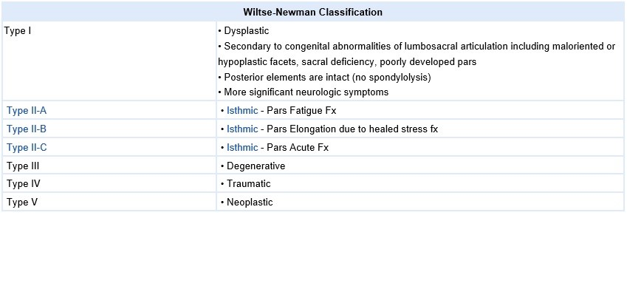

Slide 10
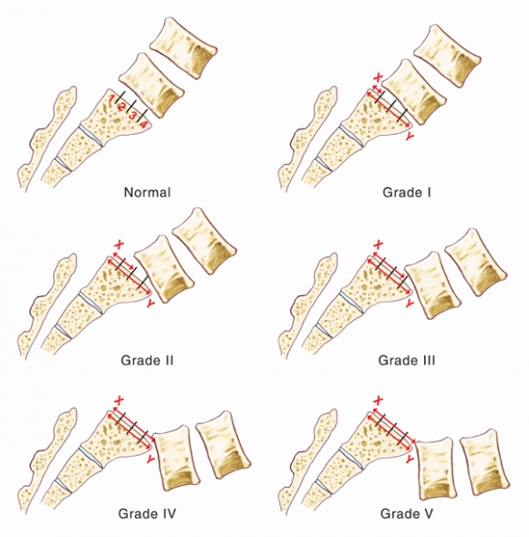

Slide 11
Grade 1 | 25% of vertebral body has slipped forward
Grade 2 | 50%
Grade 3 | 75%
Grade 4 | 100%
Grade 5 | Vertebral body completely fallen off (i.e.,spondyloptosis)

Slide 12
CAUSE
Overuse
Both spondylolysis and spondylolisthesis are more likely to occur in young people who participate in sports that require frequent overstretching (hyperextension) of the lumbar spine—such as gymnastics, football, and weight lifting. Over time, this type of overuse can weaken the pars interarticularis, leading to fracture and/or slippage of a vertebra.
Genetics
vertebral bone that is thinner than normal—and this may make them more vulnerable to fractures.

Slide 13
CLINICAL FEATURES
Difficulty in running or walking.
pain that originates in the back and travels down one of the lower extremities.
There is a sharp pain in your lower back, or in some cases, buttocks.
One or occasionally both of the legs experience weakness.
Painful symptoms are agitated when move a certain way, such as twisting the torso.
Noticeable lordosis appears in the lower back.

Slide 16
With location classification- Most commonly, this form of classification is used to determine the three subtypes of isthmic spondylolisthesis (the most common form of the condition). These subtypes are as follows:
Subtype A: pars interarticularis fatigue fracture
Subtype B: pars interarticularis elongation as a product of multiple healed stress effects
Subtype C: pars interarticularis acute fracture

Slide 17
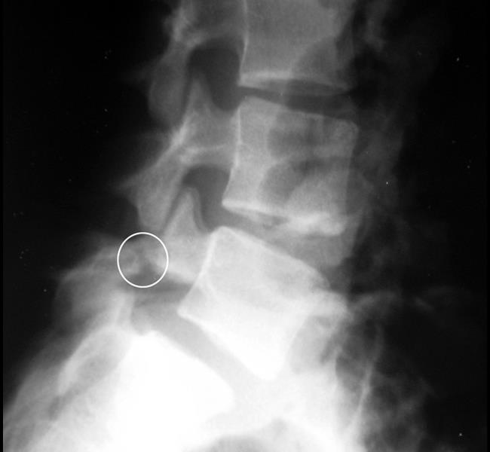
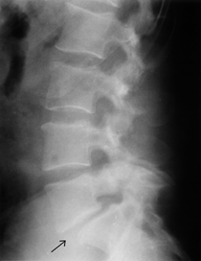
X-ray taken from the side shows a pars fracture in the fifth lumbar vertebra.

Slide 18
SURGERIES
Pars repair
Spinal decompression
Spinal fusion

Slide 19
PHYSIOTHERAPY MANAGEMENT
SHORT TERM GOALS
Patient education
To improve posture
Pain control
Healing when possible
Restoration of normal function including return to sports
To improve strength
To improve stability
To improve flrxibility
LONG TERM GOALS
To maintainance strength
To maintain stability

Slide 20
Thermotherapy – SWD and ultrasound
Bracing – TLSO
Exercises to correct deformity
Isometric and isotonic exercises beneficial for strengthening of the main muscles of the trunk, which stabilize the spine. These techniques may also play a role in pain reduction
Core stability exercises useful in reducing pain and disability in chronic low back pain in patient with spondylolisthesis
Movements in closed-chain-kinetics, antilordotic movement patterns of the spine, elastic band exercises in the lying position
Gait training
Stretching and strengthening exercises, objective of stretching and strengthening is to decrease the extension forces on the lumbar spine, due to agonist muscle tightness, antagonist weakness, or both, which may result in decreased lumbar lordosis.In order to improve the patient’s mobility stretching exercises of the hamstrings, hip flexors and lumbar paraspinal muscles are important.

Slide 21
Balance training including - Sensomotoric training on unstable devices, walking in all variations, coordinative skills
Hydrotherapy
Endurance training of muscles, effective for chronic low back pain
Cardiovascular exercise - Athletes with spondylolysis and first-degree spondylolisthesis can take part in all sports activities. However, attention should be given to those kinds of sport where recurring trauma resulting from repeated flexion, hyperextension and twisting is usually undertaken (e.g. gymnastics, aerobics, swimming in the dolphin technique). Athletes with a grade 2, 3 or 4 can also participate in all the sport activities but have to do this with a special and individually adapted directive.Low aerobic impact sports are highly recommended. Sports that certainly can be practiced are walking, swimming and cross-training. Although these activities will not improve the shift, these sports are a good alternative for cardiovascular exercises. Impact sports like running should not be done in order to avoid wear. The adolescent athlete or manual laborer should avoid hyperextension and/or contact sports.

Slide 22
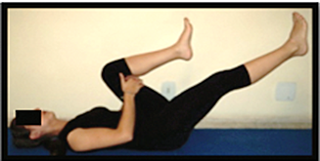
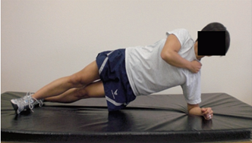
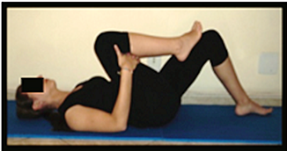
Strenghthening of deep abdominal muscles
Alternating legs, with leg extension while exhaling, maintaining contraction of transverse abdominis, paravertebral and pelvic floor muscles
Core stability
Stretching of erector spinae muscle

Slide 23
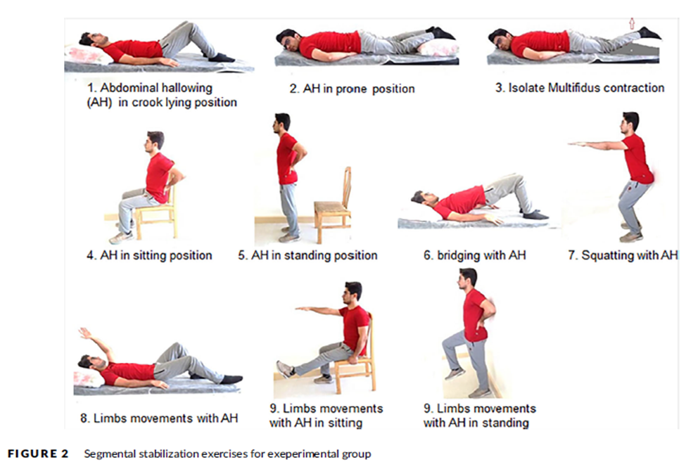

Slide 24
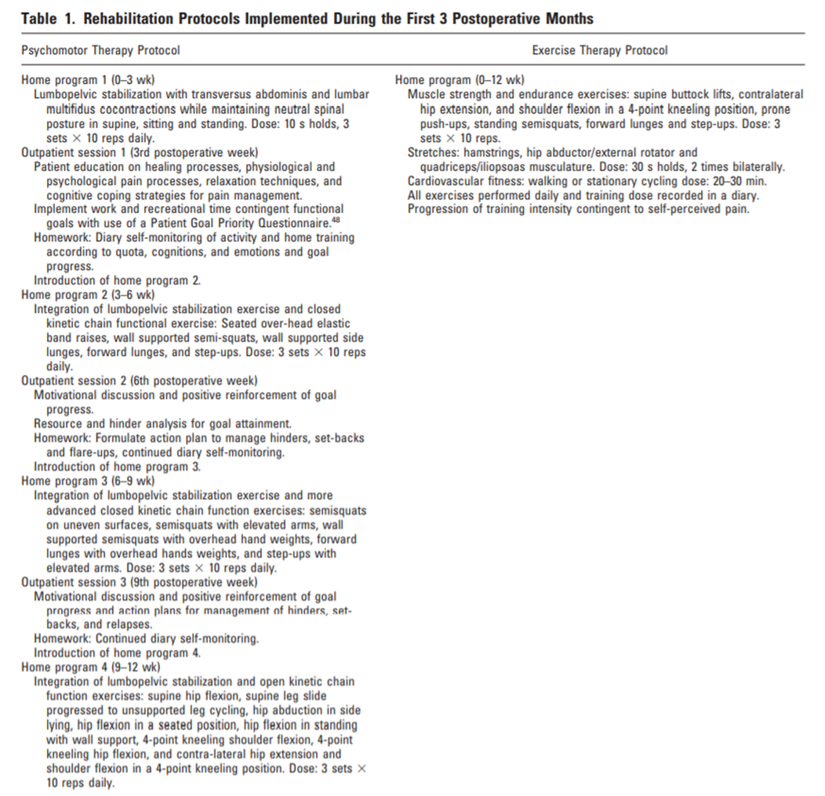

Slide 27
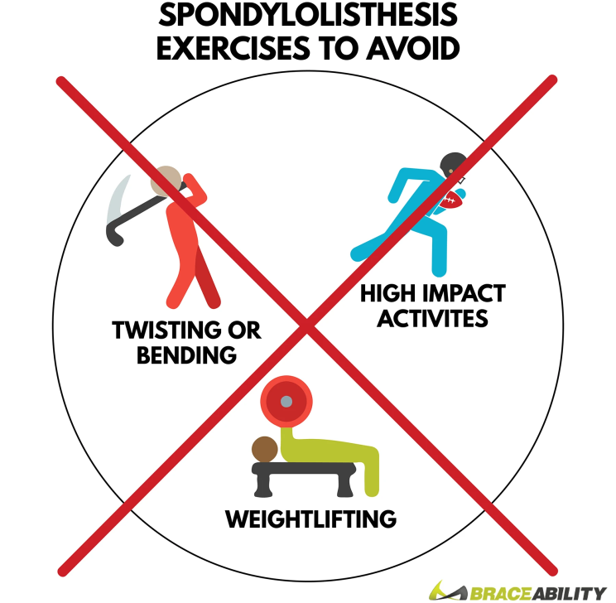
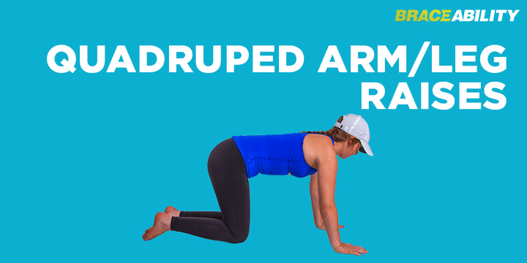
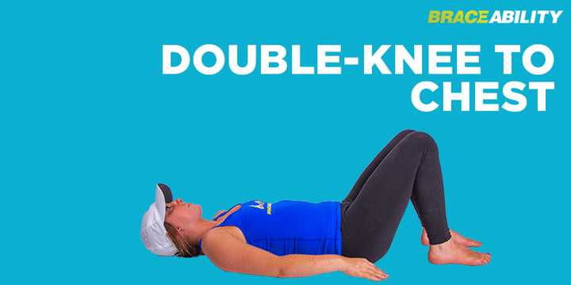

Slide 28
A Home Exercise Program must include exercises that: - Correct an abnormal anterior pelvic tilt. - Stretch tight lower back muscles to relieve pain. - Strengthen deep core muscles to stabilize your lumbar spine.
PELVIC CLOCK STRETCHES
1. Knee to chest stretch
2. Exercise “12 HOLD” EXHALE and tilt your pelvis back toward the 12 o’clock marker, in the direction of your head. HOLD this position for five seconds without breathing. Press both QL muscles against the floor. INHALE and return to neutral position. REPEAT 10 times.
3. “Clockwise & Counterclockwise” -Clockwise rotation follows the 12-3-6-9 pattern. Counterclockwise rotation follows the 12-9-6-3 pattern. Imagine that the axis of the rotation extends from your navel through the center of the device. Then move your pelvis and hips in a circular direction around that center of rotation. Repeat 10 times.
CORE STABILITY EXERCISES- Arms Up, Balance on Heels, Balance on One Heel, Dead Bug, Dead Bug Moving Legs.

Slide 29
Phase I Active Rest Weeks: 0-6 weeks
Immobilization (usually determined by physician)
Bracing is recommended if patient is experiencing pain with activities of daily living o
If patient only has pain with higher level and/or sporting activities they may not require bracing
Specific Instructions: avoid loading the spine, lumbar extended positions
Treatments: Modalities as indicated: ultrasound, electrical stimulation, heat, ice to control pain ROM/flexibility (encourage decreased lumbar stress during extension movement):
o Shoulder flexion and latissimus dorsi stretching
o Hip flexor stretching
o Hamstring stretching
o Hip rotation stretching
o Thoracic extension mobilization/manipulation and o Side lying clam shell o side lying hip abduction
o Abdominal isometric

Slide 30
Phase II Early Strengthening Weeks 6-9
Specific Instructions: - Continue to avoid excessive spinal loading and spinal extension - discontinue brace if no pain with activities of daily living
Modalities as indicated o Ultrasound, heat, electrical stimulation to control pain and stiffness
Manual therapy
o Soft tissue mobilization paraspinals, quadratus lumborum, gluteals, piriformis as needed
ROM/flexibility (continue from phase I)
Strengthening:
o Begin neutral trunk stabilization
o Front plank
o Side plank o Curl up
o Bridging
o Closed-chain gluteal strengthening
o Side step band walk
o Band squat isometric
o Standing clam
o Focus on isometric holds to improve endurance of the trunk and gluteals
Cardiovascular: treadmill walking, biking, elliptical if no pain during or after

Slide 31
Phase III Fundamental Movements and Advanced Strengthening 9-12 weeks
Strengthening:
o Continue neutral trunk stabilization – progress to unstable surface
o Front plank
o Side plank o Curl up
o Bridging
o Arm-opposite leg lifting
o Closed-chain gluteal strengthening
o Side step band walk
o Goblet squat
o Single limb strengthening
▪ Upper body movements • Chest press • Overhead press • Pull-downs
▪ Lower body movements • Single leg squat • Single leg dead lift o Loaded carry Cardiovascular: begin return to running progression if patient can walk for 30 minutes without pain

Slide 32
Phase IV Sport-specific Return to Sport
Continue as phase III
Plyometrics
o Begin with double limb and progress to single limb
Cardiovascular: continue return to running program, sport-specific conditioning

