Slide 1
Galvanic Current
Dr. Gaurav C. Mhaske
Dept. Of Neurophysiotherapy
MGM Institute Of Physiotherapy
Chh. Sambhajinagar

Slide 2
Definition
It is a direct current
Unidirectional
It is very painful to patients because it is unidirectional
To overcome this regular pause can be given between stimulation
Interrupted galvanic current(IGC)
Constant direct current is used for Iontophoresis
IGC is used for denervated muscle stimulation

Slide 3
It is a direct Current used to activate muscle directly, without activation of the peripheral nerve.
Direct muscle stimulation requires pulse or phase durations of at least 1 milliseconds, and more often uses even longer durations.
Dosage:
A regular 20-30 contractions with an average of 90- 200
contractions per muscle per day.
Cease when motor point responds to faradic current.

Slide 4
Evidence for
appropriate electrical stimulation can cause a denervated muscle to contract
contraction of a denervated muscle may help limit edema and venous stasis within the muscle, and therefore delay muscle fiber degeneration and fibrosis
recovery time following denervation appears to be shortened with appropriate electrical stimulation

Slide 5
Evidence against
contraction of the denervated muscle may disrupt regenerating neuromuscular junctions and subsequently delay re-innervation
denervated muscle is more sensitive to trauma than innervated muscle, and electrical stimulation may further traumatize the denervated muscle
prolonged electrical stimulation until reinnervation occurs is not worth the financial and time costs involved

Slide 6
Unipolar Vs Bipolar Motor PointStimulation
 | Unipolar Motor Point Stimulation | Bipolar Motor Point Stimulation
Electrodes Used | One small activeelectrode and one largedispersive electrode | Equal sized electrodes
Site of Stimulation | Motor point for stronger response | Effect depends onplacement
Description | Same amount of current passes thru each electrode Smaller sized electrode will have higher current density, thus effects here is stronger (active electrode) | Current density equal in both electrodes Convenient for stimulating mm groups or very large mm Equally small electrodes used for stimulating denervated mm

Slide 7
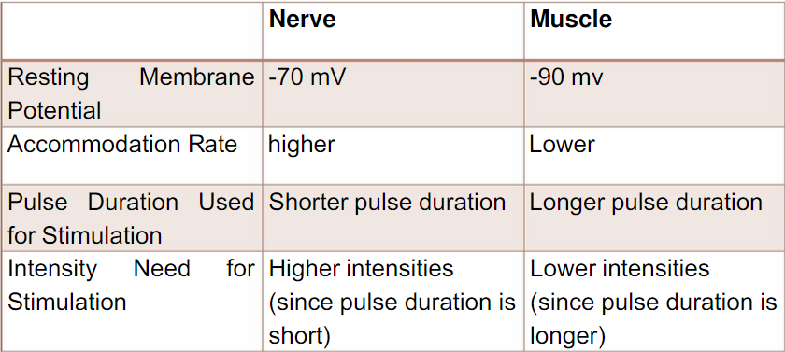
Comparison of Electrical Excitability of Nerve and Muscle

Slide 8
Stimulation of Innervated Vs Denervated Muscle
 | Innervated | Denervated
Type of Contraction | 1/sec- single brisk contraction 20/sec– partial tetany60/sec- full tetany | Sluggish
Rate of Change of Current | Sudden increase in intensity | Gradual rise in intensity
Strength of Contraction | Depends on number of motor units activated | Depends on number of muscle fibers activated
Intensity | higher | Lower
Pulse duration | Less 10 ms- short pulse duration | More than 10 ms– longer pulse duration
Chronaxie | < 1 ms | > 50 ms
Ideal current | Faradic or faradic type | IDC

Slide 9
Uses:
1. Constant direct currents are used for iontophoresis
2. Modifide direct current are used to stimulate denervated
muscles.
3. Maintain the properties of muscle.
4. Retards the denervation atrophy.
5. Helps the muscle to utilize all the substances and maintain
nutrition.
6. Improves absorption and activates pumping function of
muscle.
7. Prevents venous and lymphatic stasis.
8. Maintain the working hypertrophy of denervated muscles.
9. Maintain the extensibility of the muscles.
10.Improves local circulation.
11.Prevents contracture.

Slide 10
Stimulating Denervated Muscle
Electrical currents may be used to produce a muscle contraction in denervated muscle
Denervated muscle has lost its peripheral nerve supply
Purpose for electrically stimulating denervated muscle is to help minimize the extent of atrophy while the nerve is regenerating

Slide 11
Stimulating Denervated Muscle
Muscle fibers experience a decrease in size, diameter and weight of the individual muscle fibers
There is a decrease in amount of tension which can be generated and an increase in the time required for contraction

Slide 12
Stimulating Denervated Muscle
Degenerative changes progress until muscle is re-innervated by axons regenerating across site of lesion
If re-innervation does not occur within 2 years fibrous connective tissue replaces contractile elements and recovery of muscle function is not possible

Slide 13
Muscle stimulation with intermittent direct current
The term ‘muscle stimulation’ is used to refer to the production of a contraction in a muscle or muscle group by the application of an electrical stimulus.
The objective is to assess the response to electrical stimulation of the peripheral motor neurons and the muscle tissue.
Depending on the nature of the contraction that can be produced by means of direct current pulses, a distinction is made between single and multiple stimulation.
In single stimulation, a single contraction is produced.
Multiple stimulation leads to tetanic contraction.
With respect to the pulse type, only rectangular and triangular pulses are of interest in muscle stimulation.

Slide 14
Application of Galvanic current
Denervated muscles
Facial muscle weakness secondary to Bell’s Palsy & Facial palsy.
Iontophoresis

Slide 15
Why Galvanic over Faradic in facial muscles?

Slide 19
Contraindications
Placement of electrodes tangential to the heart
Presence of a cardiac pacemaker
Presence of malignancy
Placement of electrodes along regions of the phrenic nerve
Placement of electrodes over the carotid sinus or laryngeal musculature
Houghton et al. indicate that NMES is contraindicated “anywhere” on pregnant women; however, there appears to be no evidence for this

Slide 20
Precautions
Adequate precautions should be taken for patients with heart problems.
Placement of electrodes across the heart or trans-thoracically can cause an arrhythmia.
The device should not be used over skin eruptions or swollen, infected or inflamed areas.
Turn the unit off when applying or removing electrodes.
Do not use over the eyelids.

Slide 21
Dangers
Erythema
Burns
Electric Shock
Hypovolemic shock

