Slide 1
SHORT WAVE DIATHERMY
Dr. Abhishek Mishra Dept. Of Cardiovascular & Respiratory Physiotherapy MGM Institute Of Physiotherapy Chh. Sambhajinagar

Slide 2
OBJECTIVES
Production of SWD
Physical principles
Panel Diagram
Testing of Apparatus

Slide 3
HISTORY

Slide 4
History contd…

Slide 5
DIATHERMY
Diathermy is a Greek word meaning “through heating”
Dia= Through; Thermy= heat
Diathermies are of following types:
Short wave diathermy
Microwave diathermy
Long wave diathermy

Slide 6
Short wave diathermy
SWD is the use of high frequency electromagnetic waves of the frequency between 10⁷ and 10⁸ Hz, and a wavelength between 30 and 3m to generate heat in the body tissues
It provides deepest form of heat available to the physiotherapist

Slide 7
Principles
This type of current can only be produced by discharging a condenser through an inductance of low ohmic resistance
If a current of very high frequency is required, the capacitance and inductance should be small and vice versa
This is the mechanism of production of high frequency current

Slide 24
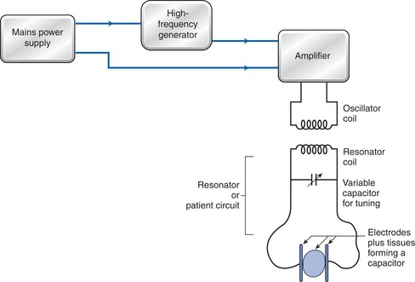
CONSTRUCTION
The Machine circuit
The Patient circuit

Slide 25
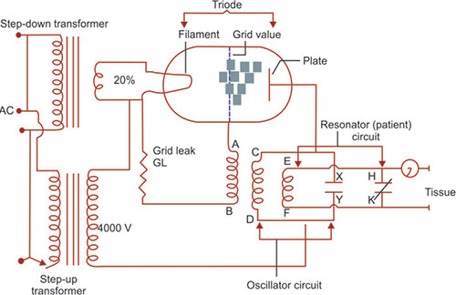
Machine circuit
It consists of two transformers, whose primary coils are connected to source AC
One is a step-down transformer and its secondary coil supplies current to the filament heating circuit triode valve

Slide 26
The other is step-up transformer and connected to Anode circuit
Oscillator circuit consists of condenser XY and inductor or oscillator coil CD
Another coil AB lie close to oscillator coil CD and has one end connected to the grid of the valve and other through grid leak GL resistance to the filament

Slide 27
The patient circuit
The patient or resonator circuit is coupled to machine circuit by an inductor coil EF lying close to oscillator coil CD and variable condenser HK

Slide 28
A matching high frequency current is produced in the resonator circuit by electromagnetic induction
Resonator and oscillator circuit must be in resonance
C1L1=C2L2

Slide 29
WORKING
The AC from main passes through primary coils of the transformer and EMF is induced in secondary coils
An EMF of 20-25V is set up in secondary coil of step-down transformer and produce current through filament of the valve
The filament is heated and thermionic emission takes place and current flows through valve

Slide 30
The EMF of about 4000V is induced in the secondary coil of step-up transformer
When Anode of the valve is positive and filament negative the current flows in anode circuit
The electrons flows from filament to anode through valve, through oscillator coil in direction C to D and to transformer back to filament
The electrons formed in CD will induce EMF in coil AB in direction that electrons will move to grid of valve making it negative thus blocking the flow of electrons from filament

Slide 31
This will lead to dying of current in anode circuit
This reduction in current will lead to self induced EMF
Lenz’s law- This EMF will try to prevent fall in current by offering resistance to flow of current
This will charge condenser X (positive) and Y (negative) polarity opposite to earlier one
Now when self induced EMF totally dies away, condenser again discharges through oscillator coil but in opposite direction D to C
Flow of current from D to C induces an EMF in AB such that electrons move from A to B and grid loses its negative charge and anode current flows again

Slide 32
This sequence continues and each time condenser charges and discharges through oscillator circuit leading to production of HF SWD
Grid leak: When the current flows across the valve some electrons are caught on the grid and grid leak is provided to enable these electrons to escape back to filament

Slide 33
The resonator coil EF lies within the varying magnetic field set-up around the oscillator coil so provided the two circuits are in resonance HFC is induced in it
The current is similar to that in the oscillator circuit and is supplied to patient

